Slide 1





STAY OK
Rethinking wellbeing at workplaces in the EU SMEs
CAREER PLANNING
MODULE 1 - MICC
2023-1-IT01-KA220-VET-000154571

Slide 2

SUMMARY
1: Introduction
1.1 Summary
1.2 Learning outcomes
1.3 Keywords
2: Lesson 1. Strategies for job satisfaction and growth
2.1 Personal and Professional Growth
2.2 Job Satisfaction and Fulfilment
2.3 Financial Stability and Growth
2.4 Work-Life Balance
2.5 Adaptability to Changing Job Market Trends
3: Lesson 2. Importance of Career Planning
3.1 Understanding Career Planning
3.2 Why Is Career Planning Important?
3.3 The Importance of Career Planning for
Employees in European SMEs
3.4 The Importance of Career Planning for the Company

Slide 3
4: Lesson 3. Strategies for Career Planning
4.1 Evaluation and Self-Evaluation
4.2. Training and Development
4.3. Mentorship and Coaching
4.4. Recognition and Reward
5: Lesson 4. Implementation Plan
5.1. Preparation Phase
5.2 The Plan Development Phase
5.3. Implementation and Monitoring
5.4. Evaluation and Improvement
5.5. Challenges of Implementing Career Planning in SMEs
6: Lesson 5. Case Studies and Real-Life Applications
6.1. Case study 1: "AdvisoTech" (France)
6.2. Case Study 2: WebGrowth Digital (UK)
6.3. Case Study 3: MediLife (Slovenia)
6.4. Case Study 4: PowerGen (Poland)
6.5. Case Study 5: AeroTech Solutions (Portugal)
6.6. Conclusion
7: Bibliography

Slide 4

Introduction
This module covers career planning for SMEs in Europe, aligning personal goals with company growth. It emphasizes skills assessment, structured training, and strategies for employee development and satisfaction.

Slide 5





Objectives
Learning Outcomes
The objective is fostering growth, job fulfilment, financial stability, work-life balance and adaptability.
This module teaches you to align personal and career goals, enhance skills and adaptability, promote well-being and growth, utilize digital tools for development.

Slide 6

TABLE OF CONTENT
This module emphasizes career planning as a strategy to align professional goals with personal values for job satisfaction. It highlights skill development, adaptability, and the role of mentorship in enhancing performance.

Slide 7
LESSON 1 :
Strategies for job satisfaction and growth
"Career planning aims to align individual aspirations with personal values and professional goals.
A strategic approach ensures both personal growth and organizational success.
Five core objectives:
Personal and Professional Growth
Job Satisfaction and Fulfillment
Financial Stability and Growth
Work-Life Balance
Adaptability to Changing Job Markets

Slide 8









Personal and Professional Growth
Personal Growth:
Develop soft skills like communication, leadership, and time management.
Foster self-confidence through continuous learning and skill enhancement.
Professional Growth:
Pursue certifications, advanced education, and practical experiences.
Transition into higher roles and responsibilities by building expertise.
Impact:
A strong foundation in both personal and professional development supports long-term career advancement.

Slide 9


Job Satisfaction, Fulfillment,
and Financial Stability
Job Satisfaction and Fulfillment:
Align roles with personal values, strengths, and passions to foster engagement.
Achieve a sense of purpose by contributing to meaningful work.
Satisfied employees are more productive and motivated, benefiting both individuals and organizations.
Financial Stability and Growth:
Achieve steady income and financial security by pursuing strategic career goals.
Plan for long-term financial health through salary negotiations, career advancements, and investments.
Secure better job positions aligned with market trends to ensure financial resilience.

Slide 10

Work-Life Balance and Adaptability
Effective career planning promotes work-life balance by fostering flexible work arrangements and clear boundaries, while adaptability is achieved through continuous skill development and staying attuned to industry trends, ensuring long-term resilience and success in dynamic job markets.

Slide 11
LESSON 2 :
Importance of Career Planning
Why Career Planning Matters
For Individuals:
  Provides clarity and direction for career goals.
  Enhances job satisfaction and personal fulfillment.
  Builds resilience and adaptability in evolving job markets.
For Organizations:
  Aligns employee skills with business objectives.
  Boosts engagement, productivity, and talent retention.
  Strengthens competitive advantage and organizational sustainability.

Slide 12






Benefits for Employees
Clarity and Structure
Increased Job Satisfaction
Skill Development
Career planning provides employees with clarity and structured paths for growth, promotes continuous skill development to meet evolving demands, and increases job satisfaction by aligning roles with personal aspirations.

Slide 13
Benefits for Companies
Improved Performance
Talent Retention and Succession Planning
Competitive Edge
Career planning enhances organizational performance, retains top talent through clear growth opportunities, and builds a competitive edge by aligning employee development with business goals.

Slide 14
The Strategic Value of Career Planning
Career planning is a pivotal tool for aligning personal aspirations with organizational goals, ensuring that individuals feel fulfilled and engaged while contributing to enhanced performance, innovation, and long-term success for companies in dynamic markets.

Slide 15
LESSON 3 :
Strategies for Career Planning
Overview of Career Planning Strategies
Effective career planning requires structured, cooperative strategies involving both the employee and the organization.
Key focus areas:
  Evaluation and Self-Evaluation
  Training and Development
  Mentorship and Coaching
  Recognition and Reward
These strategies ensure continuous growth, alignment with organizational goals, and adaptability in a dynamic job market.

Slide 16
Evaluation and Self-Evaluation
Employer Evaluation:
Assess technical and soft skills through tools like 360° feedback and competency tests.
Use Key Performance Indicators (KPIs) to track progress and align goals.
Self-Evaluation:
Encourage employees to reflect on their strengths, weaknesses, and career aspirations.
Foster accountability and self-awareness for personal growth.
Integration:
Combine employer and self-evaluation to create tailored development plans.

Slide 17
Empowering Growth
Through Strategies
Training, Mentorship, and Recognition
Training programs address skill gaps and support continuous learning to keep employees competitive. Mentorship provides guidance and personalized feedback, enhancing career growth. Recognition of achievements fosters motivation, commitment, and a positive work culture.
The Importance of Structured Strategies
Structured career planning strategies ensure employees are equipped to meet evolving challenges while aligning their development with organizational objectives. By fostering evaluation, training, mentorship, and recognition, companies can build a motivated, skilled, and adaptable workforce, driving long-term success.

Slide 18
LESSON 4 :
Preparation Phase
Key Steps:
  Form a dedicated team to oversee the career planning process.
  Conduct a skills and aspirations analysis to identify gaps and opportunities.
  Engage employees in the planning process to ensure alignment and commitment.
  Benchmark against industry standards for competitive insights.

Slide 19
Plan Development Phase
1
Defining Career Paths
2
Developing Training Programs
3
Addressing Sustainability and Digitalization

Slide 20

Implementation and Monitoring
Launch the plan with clear communication of goals, roles, and expectations.
Provide regular progress reviews and adjust strategies as needed.
Use technology to track employee development and evaluate program effectiveness.

Slide 21
Evaluation and Feedback
Regular evaluation measures the success of career planning by analyzing retention rates, performance improvements, and employee engagement. Feedback from employees helps refine training programs and development paths. An open communication culture encourages employees to share aspirations and challenges, fostering continuous improvement.

Slide 22

Overcoming Challenges
Challenges like limited resources, resistance to change, and integrating modern tools can hinder career planning. Securing management support, using cost-effective digital platforms, and adopting flexible strategies ensure effective implementation and adaptability.
Encouraging collaboration between employees and leadership helps align career planning initiatives with organizational goals for sustainable success.

Slide 23
LESSON 5 :
Case Studies and Real-Life Applications
Importance of Case Studies
Real-life case studies highlight how career planning strategies are applied in various organizational contexts. They provide practical insights into the challenges and successes of implementing career planning, offering valuable lessons for adapting these practices to different industries and company sizes. Analyzing these cases can inspire tailored strategies for individual and organizational growth.

Slide 24
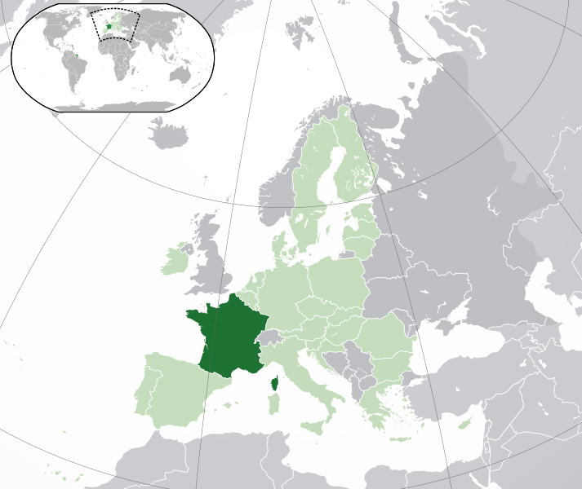

Case Study 1: AdvisoTech (France)
AdvisoTech, a small tech SME, faced a challenge with high employee turnover, which was impacting productivity and morale.
The company implemented structured career paths to provide clarity and direction for its workforce.

Slide 25

Mentorship programs paired experienced employees with new hires, while targeted training addressed skill gaps.
As a result, AdvisoTech reduced turnover by 35% and aligned employee growth with company objectives, leading to improved engagement and productivity.

Slide 26
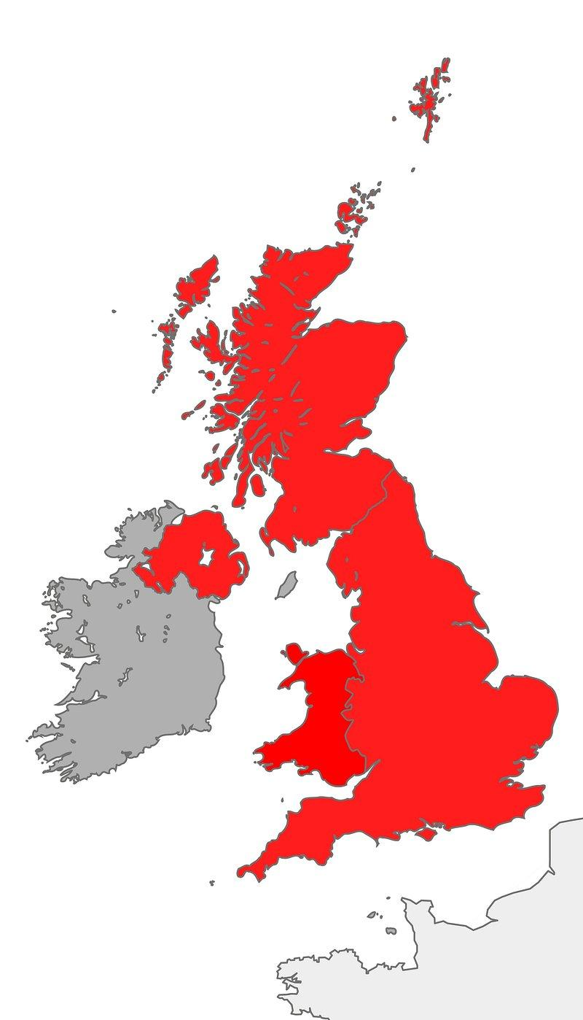

Case Study 2: WebGrowth Digital (UK)
WebGrowth Digital, a medium-sized digital marketing agency, needed to stay competitive in a rapidly evolving industry.

Slide 27

The company introduced continuous upskilling programs focused on emerging digital trends and offered flexible work arrangements to enhance work-life balance.
Regular feedback sessions and evaluations ensured alignment with industry needs. These initiatives not only maintained WebGrowth Digital’s competitive edge but also improved employee satisfaction and retention.

Slide 28
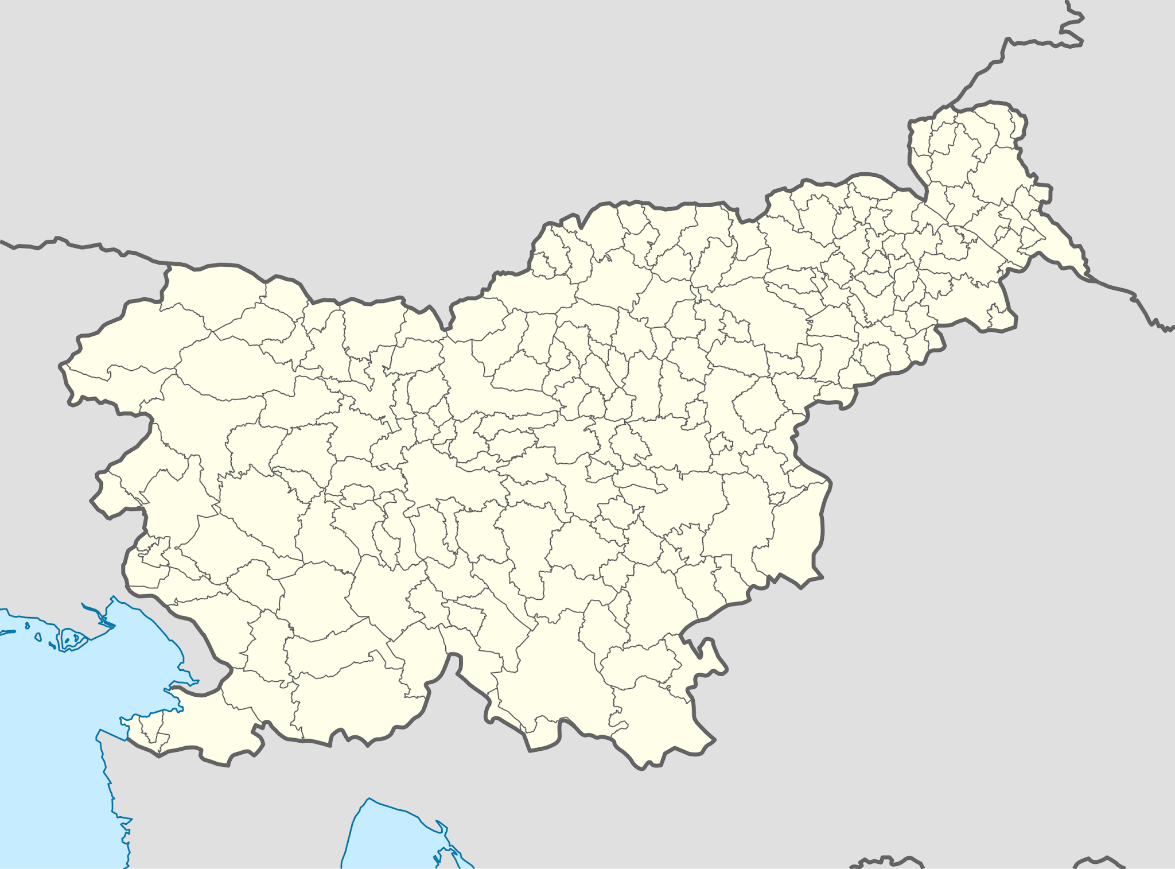

Case Study 3: MediLife
(Slovenia)
MediLife, a healthcare provider, struggled with skill gaps as it expanded its services. To address this, the company introduced advanced training modules and collaborative learning platforms for staff development.

Slide 29

Employees were encouraged to transition into specialized roles, improving service quality and boosting job satisfaction.
MediLife’s approach demonstrated how career planning could simultaneously benefit employee development and organizational performance.

Slide 30
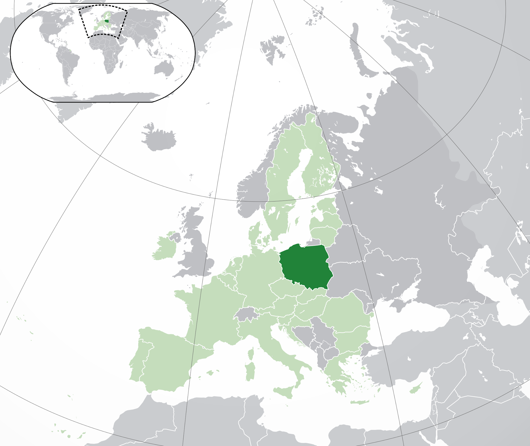


Case Study 4: PowerGen (Poland)
PowerGen, a renewable energy SME, focused on sustainability and innovation.

Slide 31

It integrated digital tools into career planning, allowing employees to map their skill development with company goals. Training programs on renewable energy technologies and leadership coaching prepared employees for advanced roles.
The initiative strengthened the company’s leadership pipeline and reinforced its commitment to green energy.

Slide 32

Case Study 5: AeroTech Solutions (Portugal)
AeroTech Solutions, an aerospace engineering firm, faced challenges in retaining specialized talent.

Slide 33

The company designed a career planning framework that included clear career progression paths, skill certifications, and competitive benefits.
This strategy significantly enhanced workforce morale, ensuring stability in a highly specialized industry.

Slide 34
Recap of Career Planning Essentials
Career planning is a strategic process that benefits both individuals and organizations. For individuals, it provides clarity, growth, and adaptability in an evolving job market. For companies, it aligns employee development with organizational goals, improving engagement, retention, and performance.
By incorporating structured strategies like self-evaluation, training, and mentorship, career planning fosters long-term success and resilience.

Slide 35

Final Thoughts and Call to Action
Effective career planning is a continuous, collaborative effort that requires commitment from both employees and employers. Organizations should prioritize creating supportive environments, while individuals must remain proactive in their development. Embracing career planning not only ensures professional fulfillment but also drives organizational innovation and growth.
Start today by evaluating your goals, identifying opportunities, and taking actionable steps toward success !

Slide 36




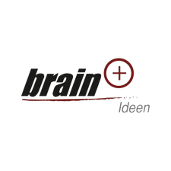



Thank You
For Your Attention
Funded by the European Union. Views and opinions expressed are however those of the author(s) only and do not necessarily reflect those of the European Union or the European Education and Culture Executive Agency (EACEA). Neither the European Union nor EACEA can be held responsible for them.

