Slide 1





STAY OK
Rethinking wellbeing at workplaces in the EU SMEs
STRATEGIES FOR
HYBRID WORKING
- Module 2 –
Brainplus Ltd
2023-1-IT01-KA220-VET-000154571

Slide 2

INTRODUCTION
  The Covid-19 pandemic has led to challenges and opportunities in the service sector.
  Winning strategies: only in a new modern, feel-good workspace
  The future of the workspace is hybrid.
  However, hybrid working needs to be well planned in terms of :
    Organisation
    Communication
    Collaboration

Slide 3


LEARNING OUTCOMES
In this series of lessons, you will learn:
You will master the skills to:
to understand the term “hybrid workspace”;
how the hybrid workspace should be managed from an organisational and technical perspective;
how to implement hybrid workspaces in the office culture;
reflect on the efficency of your work in a hybrid workplace;
communicate and collaborate effectively in a hybrid workplace;
Organise a hybrid working day.

Slide 4

Lesson 1 Definition of hybrid working models advantages and disadvantages | Lesson 2 design of hybrid working models Hybrid working in SMEs | Lesson 3 communication and collaboration the role of cloud computing
Lesson 4 overcoming challenges promoting productivity | Lesson 5 organizational culture corporate identity | SUMMARY

Slide 5
Lesson 1 Definition of hybrid working models advantages and disadvantages | Lesson 2 design of hybrid working models Hybrid working in SMEs | Lesson 3 communication and collaboration the role of cloud computing
Lesson 4 overcoming challenges promoting productivity | Lesson 5 organizational culture corporate identity | SUMMARY

Slide 6


Lesson 1: Key takeaways
  Balance between spatial and temporal flexibility is a key aspect of hybrid working
  Technological development plays a decisive role
  Advantages: flexibility, autonomy → job satisfaction
  Challenges: maintaining corporate culture + social isolation
            A comprehensive work policy is needed:
            integrating labour regulations, organisational culture, working hours, spatial flexibility and health protection

Slide 7

DEFINITION
HYBRID WORKING
Symbiosis of on-site work and remote working
Adaptability to individual and organisational requirements
Different approaches: from fixed office days to demand-oriented physical presence
Challenge: combining traditional processes with new forms of flexibility
Crucial role of digital technologies

Slide 8






PRACTICAL PART: CHECKLIST
Working environment
Access to the workplace is safe and convenient.
Light, air, climate and noise in the workspace
Technical equipment
Work tables and chairs
Notes:
Working environment
☐ The workstation is large enough.
☐ The room should be over 8.0 m² in size and at least 2.5 m high.
☐ The movement area on the side of the chair should be approximately 1.5 m by 1.0 m.
☐ The furniture at the workstation is set up appropriately.
☐ The desk and screen should be positioned at right angles to the windows wherever possible
to avoid reflections and glare.
Access to the workplace is safe and convenient.
☐ The room should be accessible via normal corridors and stairs (no ladders).
☐ The width of the access to the desk should be at least 0.6m.
☐ Care should be taken to ensure that there are no obstacles on the floor of the study, such
as cables that could be tripped over.
The light, air, climate and noise in the workspace are pleasant and are not perceived as disturbing.
☐ Care should be taken to ensure that access to the window and radiators is unobstructed.
☐ The workspace at home should also have at least one window with a view to the outside
so that you can look out and sufficient daylight can enter the room.
☐ The windows should be fitted with a device to prevent direct sunlight (e.g. curtains, blinds).
Ideally, the artificial light should have a neutral color (without color cast, preferably warm
white) and illuminate the workplace sufficiently.
☐ In the cold season, it should be possible to regulate the room temperature (approx. 21°C as a
guide).
☐ The noise level in the room and noises entering the room from outside should be quiet
enough not to disturb concentration
Technical equipment
☐ The computer is stable and set up for comfortable working.
☐ The screen should stand securely on the tabletop and be large enough for the work task;
the character size in relation to the viewing distance is important here.
☐ In addition, keyboards and computer mice that meet ergonomic requirements and are
separate from the screen should be used.
☐ The screen should be free of or at least low in reflections and the screen height should be
adjustable so that the upper display line is approximately slightly below eye level.
☐ There should be a hand rest area at least 10 cm deep in front of the keyboard.
Work tables and chairs
☐ Work table and work chair are adapted to the person or adjusted correctly so that a relaxed
sitting position can be adopted
☐ The work table should be large enough (160 cm by 80 cm as a guideline for office work) and -
just like the work chair - stable.
☐ The task chair should have five castors, be height-adjustable and offer good back support.
☐ For higher table heights and seat heights, a footrest should be used by shorter people.

Slide 9



DEFINITION
HYBRID WORKING
Management goals in hybrid working:
strike a balance between individual needs
and fair treatment for all
be inclusive
maintain corporate culture and organisational coherence regardless of the indiviual’s place of work

Slide 10

Overview of hybrid working models
Focus on efficiency and employee satisfaction
Create a win-win situation for employees and employers
Flexibility and work-life balance:
variable office presence makes it easier to reconcile personal commitments with professional requirements
the working day varies depending on the field of activity → careful planning is needed
Balance between work and leisure time + increased productivity → only if the individual life circumstances of the employee are taken into account
conscious design and management are a critical success factor

Slide 11






Digital communication
DO NOT MEASURE
THE QUALITY
OF
COMMUNICATION
BY VOLUME ALONE
CHECK
INTERACTIONS
FOR THEIR
EFFECTIVENESS
ENSURE THAT
DIGITAL EXCHANGE
DOES NOT NEGLECT
THE SOCIAL NEEDS
OF YOUR EMPLOYEES

Slide 12


Potential advantages and disadvantages (1)
Flexibility → motivation & job satisfaction | Flexibility → less organisational coordination
personalisation of working methods adapting work to individual circumstances improved work-life balance | personalisation of working methods compromising the cohesion within the team compromising the work process
more autonomy of employees greater sense of responsibility increased personal initiative | more autonomy → potentially more stress and demands, if there are no clear communication guidelines
More freedom → more loyalty to the company | Not all employees are equally willing or able to develop self-discipline.

Slide 13
Potential advantages and disadvantages (2)
Reducing commute times: better work-life balance flexibility, employee satisfaction less carbon footprint | Physical distance loss of social contacts and networking opportunities high potential for social isolation, loneliness, loss of the sense of belonging countermeasures are needed to promote social bonding and employee identification with the company: virtual team meetings and/or regular physical meetings

Slide 14









HYBRID WORKING POLICY
----
Not just a list of rules
  A holistic approach is essential
Pay attention to data protection
Develop continuously
Seek employee feedback
and experience
Respond to it
  Deal with psycho-social challenges
  Engage in socialising initiatives
  Design workplaces sustainably

Slide 15



DIRECTIVE | GUIDELINE
Set of recommendations “If you could be on site once a week, that would be great.” | set of rules “Hybrid team members need to be in the office at least two days in a week.”
See the difference?
Eliminate stress and confusion by stating
guidelines and directives clearly.
What is your model? Remote first? Office first? At will?

Slide 16








HOW TO DEVISE CLEAR GUIDELINES?
Some tips
Discuss with employees and other
managers
  Be as specific as possible
  Make it your own
  Remain open to feedback
  Share your hybrid work policy unconditionally
Notes:
Tips for clear guidelines
Discuss with employees and other managers
Consider everyone’s expectations so that you won’t have to change the guidelines every month.
Be as specific as possible
The main goal is to avoid confusion → therefore provide simple and comprehensive guidelines
That is: be specific and cover as many questions as possible
Make it your own
There is no one-size-fits-all model.
Customise and tailor your strategy to the needs of the model.
Remain open to feedback
The hybrid strategy may not be well received by the employees.
Remain open to discussion
Uncover weakness and correct them ASAP.
Share your hybrid work policy unconditionally
Send it to everyone by e-mail
Talk about it in team meetings
Download it to your collaboration tool (Notion etc.)
Hang the most important points on the walls of the common areas (corridors, open spaces…)

Slide 17
The 5 W’s
Why?
Who?
When?
What?
Where?

Slide 18
  Developing and implementing rules for hybrid working: the “scrum” principle
Develop/revise a first version of the rules
Communicate that this is an initial version with gaps and inaccuracies which will be improved
Communicate that a be reevaluation will take place after 2 months based on learning experience
Continuously incorporate learning experiences into the rules of the game

Slide 19
Lesson 1 Definition of hybrid working models advantages and disadvantages | Lesson 2 design of hybrid working models Hybrid working in SMEs | Lesson 3 communication and collaboration the role of cloud computing
Lesson 4 overcoming challenges promoting productivity | Lesson 5 organizational culture corporate identity | SUMMARY

Slide 20
Lesson 1 Definition of hybrid working models advantages and disadvantages | Lesson 2 design of hybrid working models Hybrid working in SMEs | Lesson 3 communication and collaboration the role of cloud computing
Lesson 4 overcoming challenges promoting productivity | Lesson 5 organizational culture corporate identity | SUMMARY

Slide 21
GOAL OF THE LESSON
  Understand the design of remote working in HR management, especially in the context of SMEs.
STRUCTURE
  (i) Plan and design of remote workplaces
  (ii) monitoring and management of remote working
  (iii) practical examples

Slide 22
PLAN AND DESIGN
OF REMOTE WORKING STATIONS
  A fundamental redesign is needed to take into account functional and psychological needs of employees
  The home office should be ergonomically and technologically well-equipped
  In particular: ergonomic office furniture and a reliable IT infrastructure
  Protection of company data

Slide 23




MONITORING
BALANCE EMPLOYEE AUTONOMY
AND COMPANY GOALS
RESPECT PRIVACY
USE TECHNOLOGY…
ESTABLISH A RELATIONSHIP OF TRUST
… AND BEWARE OF ITS LIMITATIONS;
ADAPT IT TO COMPANY NEEDS
DESIGN FEEDBACK PROCESSES TO IMPROVE PERFORMACE

Slide 24


PRACTICAL PART: HOME OFFICE GUIDE
First consideration when you set up a home office: how long will you need it?
It makes no sense to spend thousands of euros on a home office you’d use only
occasionally.
A bridging solution for long-term use would be annoying:
e.g., working on the kitchen table.

Slide 25


THREE BASIC GUIDELINES
A home office should be:
SEPARATE
STATIONARY
COMPATIBLE
An office should have its own designated space.
Moving between different locations can destroy your workflow.
Find a well-lit place – preferably by the window, clutter-free, and not distracting.

Slide 26

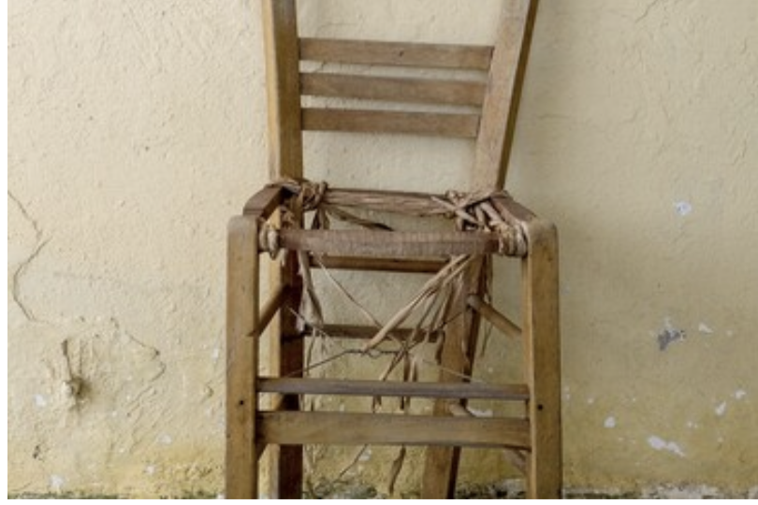





Tips and suggestions for purchases
You shoudn’t save money on a desk chair.
Many conference calls? Invest in a good webcam.
A stable internet connection is essential.
Ethernet > WLAN
Humidifier or fan for sufficient air exchange
Height-adjustable desk and/or monitor to prevent back pain
A desk lamp, esp. if you work in the evening

Slide 27
BYOD: BRING YOUR OWN DEVICE
Personal convenience and efficiency | Lack of data security
Employee satisfaction | Security gap in the network
User-friendly | GDPR compliance?
Flexible and mobile | Heterogenous software and hardware in the company
Cost saving for the company | Difficult registration for IT

Slide 28
Lesson 1 Definition of hybrid working models advantages and disadvantages | Lesson 2 design of hybrid working models Hybrid working in SMEs | Lesson 3 communication and collaboration the role of cloud computing
Lesson 4 overcoming challenges promoting productivity | Lesson 5 organizational culture corporate identity | SUMMARY

Slide 29
Lesson 1 Definition of hybrid working models advantages and disadvantages | Lesson 2 design of hybrid working models Hybrid working in SMEs | Lesson 3 communication and collaboration the role of cloud computing
Lesson 4 overcoming challenges promoting productivity | Lesson 5 organizational culture corporate identity | SUMMARY

Slide 30
GOAL OF THE LESSON
  Focus on the specific challenges that hybrid teams face and the solutions that have evolved
  Analyse and understand communication practices and tools for hybrid teams in the context of HR management
  Learn how cloud computing tools can improve learning, motivation and self-efficacy
STRUCTURE
  (i) Communication in the context of remote working
  (ii) Technical tools for remote working
  (iii) Rules for online meetings
  (iv) Practical tips

Slide 31





WHAT DOES COMMUNICATION MEAN WHEN WORKING REMOTELY?
Modularisation of work is a key component of online collobration → structure work to support clear task allocation and smooth coordination
Main challenge: not to let physical distance cause misunderstandings.
Lack of non-verbal cues
No spontaneous exchange

Slide 32


WHAT DOES COMMUNICATION MEAN WHEN WORKING REMOTELY?
WHAT DOES COMMUNICATION MEAN WHEN WORKING REMOTELY?
Establish communication standards that create a system of trust and a clear flow of information.
Create an open system of collaboration, supported by appropriate technologies
Virtual meetings can be made more
efficient using strategies –E.g.
John Hopkins University toolkit

Slide 33


TECHICAL TOOLS FOR REMOTE WORKING
TECHNICAL TOOLS FOR REMOTE WORKING
CLOUD-BASED COLLABORATION TOOLS
AGILE METHODS
Flexible, scalable, accessible
Create working conditions independent of time and space
Challenges: data protection, IT security, dependence on stable Internet connection
  A structure that optimises collaboration and individual engagement.
  Methods: Scrum, daily stand-ups, team working agreements, recurring meetings

Slide 34

TECHICAL TOOLS FOR REMOTE WORKING
TECHNICAL TOOLS FOR REMOTE WORKING
VIRTUAL AGILE METHODS
ARTIFICIAL INTELLIGENCE
  Increase communication efficiency and reduce complexity within the working environment
  Technical roles such as the Scrum Master are crucial for managing these processes.
  Challenge: adaption to changing team dynamics and project requirements.
  AI has the potential to complement and reinforce human skills.
  Requirements:
    bridge technical gaps;
    sound strategic planning;
    detailed analysis of team needs & development

Slide 35






RULES & TIPS FOR ONLINE MEETINGS
BEHAVIOURAL
NORMS
COMMUNICATION
PROTOCOLS
MUTE
FUNCTION
POLLS & BREAKOUT ROOMS
FOLLOW-ON

Slide 36


















TECHICAL TOOLS: SUGGESTIONS
TRELLO

Slide 37
Lesson 1 Definition of hybrid working models advantages and disadvantages | Lesson 2 design of hybrid working models Hybrid working in SMEs | Lesson 3 communication and collaboration the role of cloud computing
Lesson 4 overcoming challenges promoting productivity | Lesson 5 organizational culture corporate identity | SUMMARY

Slide 38
Lesson 1 Definition of hybrid working models advantages and disadvantages | Lesson 2 design of hybrid working models Hybrid working in SMEs | Lesson 3 communication and collaboration the role of cloud computing
Lesson 4 overcoming challenges promoting productivity | Lesson 5 organizational culture corporate identity | SUMMARY

Slide 39
GOAL OF THE LESSON
Discussion of how different approaches to HR management in companies influence the way they overcome internal challenges and increase productivity.
STRUCTURE
  (i) The ideal remote workspace
  (ii)How to structure a working day
  (iii) Pomodoro technique
  (iv) Practical examples

Slide 40






THE IDEAL REMOTE WORKPLACE
ERGONOMIC
TECHICALLY EQUIPPED
QUIET AND UNDISTURBED
DIGITAL COMMUNICATION
BALANCED
xx

Slide 41

HOW TO STRUCTURE A WORKING DAY
A structured routine in the home office is essential for productivity.
SOCIAL COMPONENT
CLEARLY DEFINED START AND END TIMES
SOCIAL COMPONENT
VIRTUAL EXERCISE BREAKS / ERGONOMIC TRAINING
BLOCKS OF TIME FOR CONCENTRATED ACTIVITY

Slide 42
POMODORO TECHNIQUE
Time management method
Creates clarity through clear work intervals
Motivates employees to stick to
time constraints
keeps them mentally fresh
Ensures consistently high productivity
and employee satisfaction
Intervals can be flexibly adapted
to time-sensitive tasks (meeting prep,
respond to customers etc.)
25 minutes uninterrupted work
5-minute break

Slide 43
PRACTICAL EXAMPLES
Creation of content (e.g. logos and press releases): Pomodoro technique creates structure for both concentration and productivity. The challenge is to adapt the method to the dynamic and unpredictable nature of advertising campaigns.
Project and team work:
work results are likely to be more consistent, because continuous feedback and knowledge exchange take place during breaks; collective creativity can be increased;
  An effective break structure can have a significant impact on team dynamics in SMEs: optimise team interaction and social cohesion through consciously planned breaks;
Product development: the technique allows to work in a structured and goal-oriented manner even under time pressure.
Non-profit organisations:
Challenge, because volunteers have different availabilities and time slots
Create flexible but clear framework conditions that meet both individual and organisational needs

Slide 44
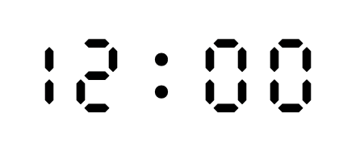

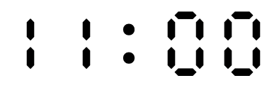

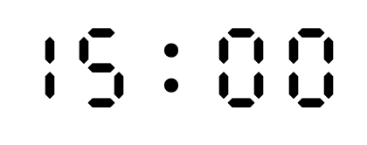
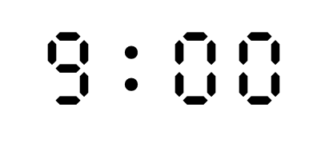
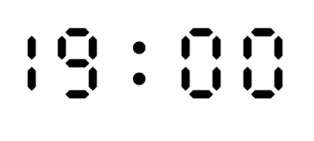
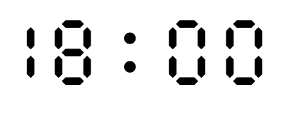
  A typical day at the
  Vanilla Mind Office
GO TO BED
OATMEAL;
CONTINUE WORK
START WORK
WAKE UP
WORK AGAIN
BREAK
COOKING

Slide 45
Lesson 1 Definition of hybrid working models advantages and disadvantages | Lesson 2 design of hybrid working models Hybrid working in SMEs | Lesson 3 communication and collaboration the role of cloud computing
Lesson 4 overcoming challenges promoting productivity | Lesson 5 organizational culture corporate identity | SUMMARY

Slide 46
Lesson 1 Definition of hybrid working models advantages and disadvantages | Lesson 2 design of hybrid working models Hybrid working in SMEs | Lesson 3 communication and collaboration the role of cloud computing
Lesson 4 overcoming challenges promoting productivity | Lesson 5 organizational culture corporate identity | SUMMARY

Slide 47
TOPIC
  IMPACT OF HYBRID WORK ON ORGANISATIONAL CULTURE IN SMEs
  How can organisational culture, once so closely linked to shared physical spaces, still act as a unifying element within companies today?
  Learn how cloud computing tools can improve learning, motivation and self-efficacy
STRUCTURE
  Fundamentals of organisational culture
  Transformation of hybrid working models
  Practical examples
  Transfer to practice of HR management in SMEs
Notes:
Let's imagine it was December 31, 2019, and we were looking into the near future of the
following year. Who could have predicted the dramatic shift in our working world triggered
by the global COVID-19 pandemic at that time? The pandemic has challenged us in many ways
and forced us to rethink traditional work concepts. The resulting hybrid working models,
where parts of a team work remotely and others from traditional office environments, may
be an evolutionary step in the development of team dynamics or a direct response to the need
created by global changes. This chapter is dedicated to analyzing communication and
collaboration practices and tools for hybrid teams in the specific context of human resource
management.
The topic of this chapter is of great relevance in the current discussion about hybrid work
systems. The focus is on the specific challenges that hybrid teams face and the solutions that
have evolved in the wake of digitalization and the need for adaptability. The findings from this
analysis are essential for the design of work environments in which hybrid teams can
communicate and collaborate effectively, thereby increasing both individual and collective
productivity.
The aim of this chapter is to identify and evaluate effective methods and tools for increasing
effectiveness and engagement in hybrid teams. It shows which communication practices and
collaboration tools are best suited in the HR management context to overcome the specific
challenges of hybrid teamwork and improve work outcomes.
The state of research on hybrid teamwork is complex and is in a dynamic development
process. The pandemic has acted as a catalyst for research and development in this area. This
chapter draws on a variety of studies and analyses, including the work of Analysis Mason,
which highlights the need to adapt collaboration solutions to hybrid work environments, and
the research of Al-Samarraie and Saeed, which demonstrates how cloud computing tools can
improve learning outcomes, motivation and self-efficacy through flexibility and accessibility.
In terms of structure, this chapter is organized as follows: This introduction, which provides
an overview of the topic and approach, is followed by an in-depth look at the importance of
communication in hybrid work environments and its impact on teamwork. Chapter 3 is
dedicated to the exploration and evaluation of technical tools that are essential for remote
work and the associated collaboration and communication. Chapter 4 discusses rules for
online meetings and how they can facilitate effective virtual gatherings. Chapter 5 presents
practical examples of successful hybrid teamwork in order to combine theoretical approaches
with real-life scenarios. The final conclusion in chapter 6 summarizes the insights gained and
provides an outlook on future developments in the field of hybrid teams.

Slide 48




What does “organizational culture” mean?
Hybridity has a lasting impact on the cultural framework of SMEs.
It influences traditional social structures and normative convictions.
Fusion of physical and digital interaction new social dynamic
Ensure both effectiveness and humanity in communication:
maintain a cohesive culture

Slide 49



What does “organizational culture” mean?
Hybrid work models influence not only individual roles,
but also collective ones: the image of “we”
Important role of managers as role models for instilling consistent,
organisation-wide culture
Teaching: digital technology; incorporating both physical and digital realities

Slide 50
How can culture be changed through
remote working?
ORGANISATIONAL ADAPTATION
ADAPTATION OF MANAGEMENT STYLES
Cannot be based on digital technology alone
Maintain rituals and traditions, even if only in digital form
Set up communication channels for networking and exchange within the organisation
Shift towards trust-based leadership;
strike the right balance between autonomy and strategic direction;
inspire and motivate employees from a distance
DIGITAL TOOLS
Use them for cultural mediation
Examine whether they strengthen the corporate culture or lead to fragmentation
PROMOTION OF SELF-MANAGEMENT AND INITIATIVE
Goal: Freedom within a defined framework, e.g. intarget agreements: allow freedom for individual approaches but still clearly define the results to be achieved
Challenge: provide sufficient guidance without restricting personal autonomy of the employees.
Ideal: culture that rewards initiative but also offeres support in the face of challenges
CLEAR COMMUNICATION OF GOALS
  Physical distant must not translate in mental distance;
  Ensure that everyone share a common understanding on the organization’s goals and values;
  Design platforms in such a way that they enable not only information flows, but also cultural exchange and the formation of a common identity.

Slide 51



PRACTICAL EXAMPLES
Promote employee loyalty through targeted measures:
flexible working hours,
flexible locations,
combining on-site and remote workng
Design innovative onboarding processes:
Communicating the corporate culture is crucial.
Take into account both physical and virtual elements of onboarding.
Sponsorship programmes and regular feedback are key for promoting a sense of belonging.
Adapt the office infrastructure:
The physical office environment should be design to support both individual and team work.
It should also reflect the values of the organisation.

Slide 52





CONCLUSION
5 TIPS FOR REMOTE TEAM BUILDING
MAINTAIN RITUALS VIRTUALLY AS WELL
WEEKLY MEETINGS
COMPANY KITCHEN
AT LUNCHTIME
CREATE A SHARED
COMPANY PLAYLIST
PLAY ONLINE
TABLE FOOTBALL

Slide 53




CONCLUSION
5 TIPS FOR REMOTE TEAM BUILDING
CELEBRATE EVERYDAY EVENTS
ASK COLLEAGUES TO SHARE HIGHLIGHTS FROM THE PAST WEEK
DESIGN MOTIVATIONAL
CARDS

Slide 54



CONCLUSION
5 TIPS FOR REMOTE TEAM BUILDING
VALUE PERSONAL CONTACT
USE CHATS,
NOT ONLY E-MAIL…
…AND VIDEO
CHATS TOO
ORGANISE
STAND-UP MEETINGS

Slide 55



CONCLUSION
5 TIPS FOR REMOTE TEAM BUILDING
THROW DIGITAL PARTIES FROM HOME
CELEBRATE BIRTHDAYS, ANNIVERSARIES…
ORGANISE EVENTS: VIRTUAL COOKING,
GAMES, DIGITAL ESCAPE ROOMS...

Slide 56



CONCLUSION
5 TIPS FOR REMOTE TEAM BUILDING
SEND GREETING CARDS OR GIFTS
ON INDIVIDUAL ANNIVERSARIES
NOT DIGITAL ONES!
A CARD IN THE LETTERBOX
IS MORE PLEASANT

Slide 57








Thank You
For Your Attention
Funded by the European Union. Views and opinions expressed are however those of the author(s) only and do not necessarily reflect those of the European Union or the European Education and Culture Executive Agency (EACEA). Neither the European Union nor EACEA can be held responsible for them.

