Slide 1

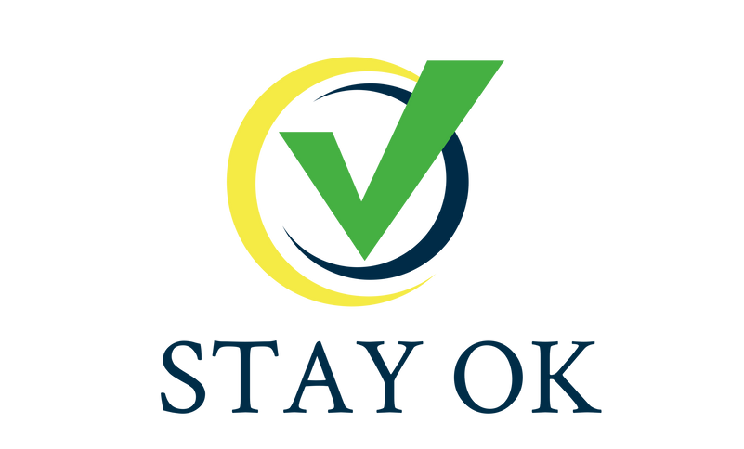



STAY OK
Rethinking wellbeing at workplaces in the EU SMEs
Module 3
AI & Worker Management
2023-1-IT01-KA220-VET-000154571

Slide 2


LESSONS 1 - 2
  Lesson 1: Introduction
    1.1 Context of the module
    1.2 The labor market
    1.3 Supply and demand of the labor market
    1.4 History of the labor market
    1.5 Lifecycle of a worker in a company
    1.6 How to think about artificial intelligence
    1.7 Different AI-based models
    1.8 Definition
    1.9 Current developments and outlook
  Lesson 2: Skills-Based Hiring and Well-Being
    2.1 Hiring process
    2.2 Digital transformation in recruitment
    2.3 Compliance and legal considerations
    2.4 Occupations, skills and qualifications
    2.5 Skills
    2.6 The other side: Occupations
    2.7 Education and qualification
    2.8 Mismatch
    2.9 Workplace well-being

Slide 3
LESSONS 3 - 4
  Lesson 3: Predicting Performance and Workforce Management
    3.1 Introduction
    3.2 Perspective of employers
    3.3 Other institutions
    3.4 What is performance?
    3.5 AI-Based performance evaluation
    3.6 Workforce management
    3.7 Companies using AI to manage the workforce
  Lesson 4: Increasing Performance and Efficiency
    4.1 Introduction
    4.2 Techniques for measuring performance
    4.3 Companies using AI to increase performance
    4.4 What is Efficiency?

Slide 4


LESSONS 5 - 6
  Lesson 5: Decision-Making Support
    51. Introduction
    5.2 Decision-making support and the development AI agents
    5.3 Industry cadence
    5.4 Examples for software solutions
  Lesson 6: Ethics
    6.1 Introduction and the question of data
    6.2 Reproduction of biases
    6.3 Bias against minorities
    6.4 Privacy
    6.5 Intellectual property
    6.6 Methods for detecting and mitigating bias and auditability
    6.7 Legal and ethical frameworks
    6.8 Ethical responsibilities of employers
    6.9 Job losses and social security

Slide 5
1. Introduction
Objectives:
  Understanding the context of the labor market: Explore the structure, supply-demand dynamics and factors influencing the labor market such as skills, qualifications and economic cycles.
  Understanding the underlying technology of artificial intelligence: Learn the basics of AI technology, including how it operates, key models like neural networks and its application in various sectors.

Slide 6
1.1 Context of the module
  Focus of the module: increasing performance and efficiency of corporate workforces using artificial intelligence. This module highlights various strategies, tools, and future trends.
  “Worker management” - what does it mean?
  You will gain a comprehensive understanding of the intersection between artificial intelligence (AI) and worker management. It will also focus on job matching, recruitment, and employee performance evaluation.
  This module will conclude with a discussion of the ethical implications of using AI in worker management, discussing issues such as biases, privacy concerns, and the transparency of AI outputs.

Slide 7



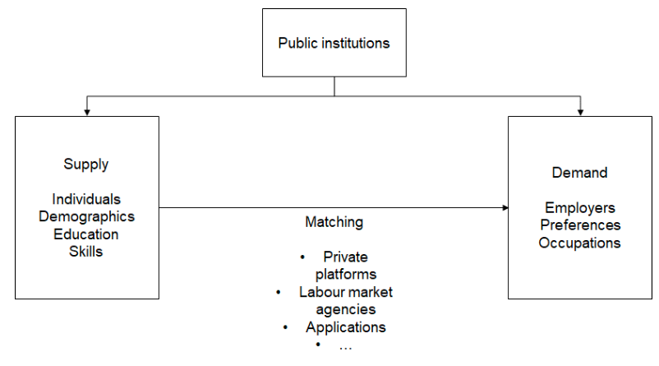

1.2 The labor market
Institutions which make up the labor market
A gigantic sorting machine.
Matches individuals with companies.
Underlying criteria: skills, qualifications, personal traits, and experiences which need to be matched with millions of job opportunities.
Matches demand and supply.
Public institutions have an interest in a functioning labor market. They invest in the development of skills through education and training.
Perfect environment for big data analytics and artificial intelligence where models analyze occupations and skills and map them to each other.

Slide 8
1.3 Supply and demand in the labor market
Demand
Supply
Relevant data
The demand in the labor market is driven by the needs of companies. Key factors that influence this demand:
The supply side of the labor market is driven by individuals. Key factors that influence this supply factor:
On a corporate level, it is necessary to decide which skills will be relevant for their future needs.
  Economic cycles
  Technological advancements: emergence of new industries like tech industry and green energy
  Government policies and public incentives like tax incentives
  Employee turnover such as retirement create vacancies
  Demographics
  Education
  Personal circumstances
  Young individuals with lack of extensive work experience
  Experienced individuals seeking new opportunities
  Longer educational pathways
  Participation rate of different demographic groups and minorities
  Abundance of data: a natural environment for big data and machine learning approaches. Skills and occupations should be a natural playing ground for artificial intelligence
  Growing body of evidence shows how algorithms make wrong decisions (e.g., Birhane, Prabhu, and Kahembwe 2021; Zou and Schiebinger 2018; Bender et al. 2021)

Slide 9

1.4 History of the labor market
Traditional careers
1990s
Demographic shifts
Digital technologies
Remote work and new employment models
Historically, careers were linear, characterized by long-term employment, predictable career patterns and job security. Today’s job market demands flexibility, adaptability, and lifelong learning (for an overview see McNulty, 1966, or Williamson, 1995).
Since the 1990s, we are witnessing the widespread introduction of computers which led to the automation of repetitive tasks. This era saw the decline of certain professions and the rise of new ones in IT and data processing, setting the stage for the Information Age.
The collapse of the Soviet Union and the opening of the Chinese market led to the economic opportunities.
Increased female employment and broader inclusion of various demographic groups. This diversity enriches teams, fosters creativity, and enhances problem-solving capabilities, challenging organizations to create inclusive work cultures to fully leverage this potential
(e.g., Campbell & Mínguez-Vera, 2008; Erhardt et al., 2003; Lorenzo & Reeves, 2018).
From 1990 onwards, digitization transformed work through the advent of the internet and new digital technologies. These changes enabled unprecedented connectivity, remote work, and virtual teams. While digitization increased productivity, it also demanded continuous education in digital skills to keep pace with technological advancements. The impact of artificial intelligence will be covered in more detail in the coming chapters.
The rise of the gig economy and freelancing, fueled by internet flexibility, has led to short-term contracts and project-based work. This offers flexibility and work-life balance, but also introduces challenges like uncertain income and lack of social security, highlighting the need for new employment models. While it increases productivity and satisfaction, it poses challenges in team cohesion, communication, and work-life separation, necessitating new strategies for effective remote work management.

Slide 10
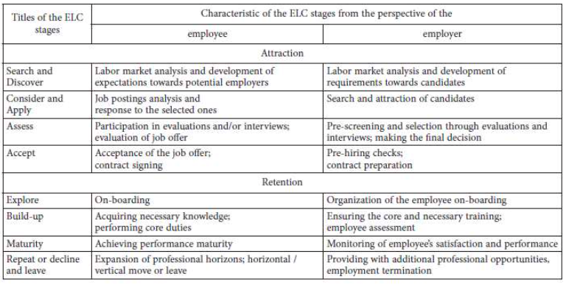
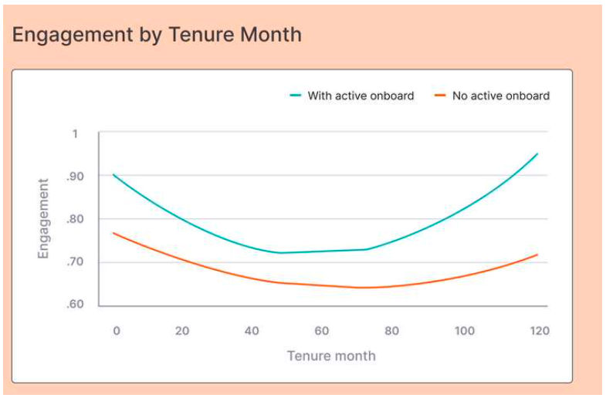
1.5 Lifecycle of a worker in a company
There are various stages of the employee lifecycle.
Gladka et al. (2022) have analyzed the various stages which have been used to analyze the lifecycle of employees and most follow similar structures shown in the table below.
The onboarding and integration process begins with orientation sessions designed to familiarize new employees with the company’s culture, values, policies, and procedures. These sessions help newcomers understand the organization’s mission and how their specific roles contribute to the overall goals of the company.
Culture Amp has shown this chart showing the difference active onboarding can have. It definitely makes sense to familiarize new employees with the colleagues and culture.
Figure 2: Stages of the Lifecycle from the perspective of employees and employers
Source: Gladka et al. (2022)

Slide 11

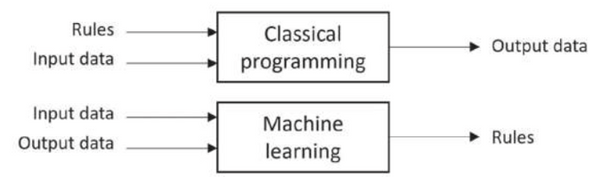


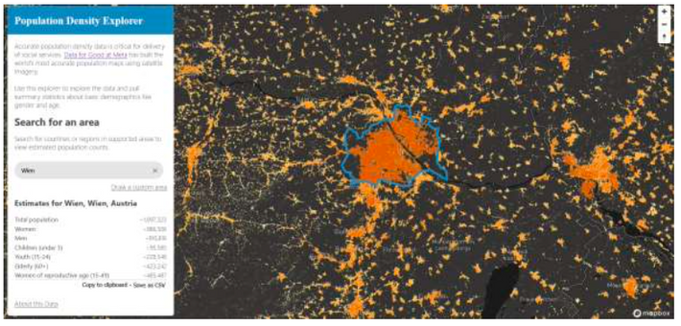
1.6 How to think about artificial intelligence
In traditional programming, a program uses explicitly defined rules to process input data and generate output data.
Artificial intelligence takes a different route. It uses input data and corresponding output data to learn and generate the rules. This method is particularly useful in situations where writing explicit rules is complex or impractical:
The maps of population density
provided by Eurostat:
  sex (male and female)
  age (under 15 years, 15-64, 65 years
and over)
  current activity status (number of employed persons), voluntary bases
  country / place of birth (place of birth
in reporting country, place of birth
  country, place of birth elsewhere)
  place of usual residence (total population)
  place of usual residence one year prior to the census
Exercise
Think about the following two questions:
How would you write the rules to differentiate a cow from a zebra? How many rules would you need, and you how would you write them?
What are the rules to identify dogs as dogs and cats as cats?
Compare this data to a dataset based on machine learning. Data for Good at Meta has used machine learning to estimate population density in grids of 30 x 30 meters (if you are interested in the methodology).
The differences between the census data and the AI-based data shows the potential for machine learning across all domains.

Slide 12
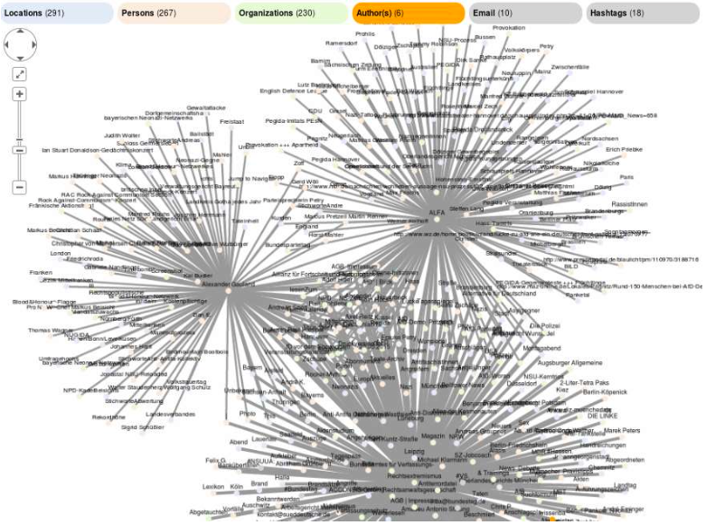
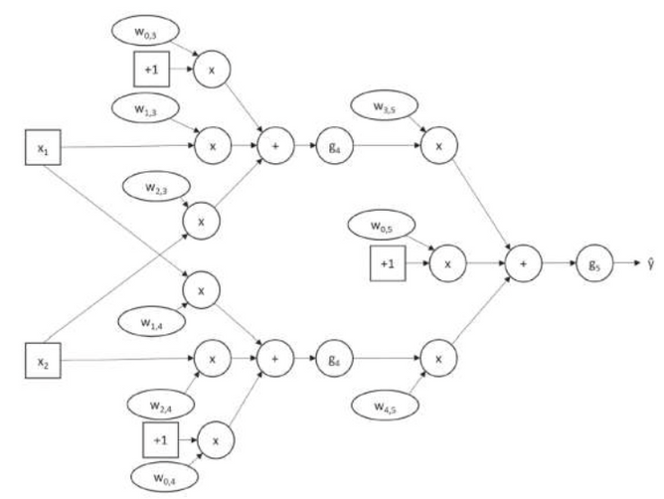
1.7 Different AI-based models
Artificial Intelligence (AI) encompasses a variety of models. The models we discuss in this chapter include neural networks, symbolic AI and evolutionary algorithms.
Neural networks are a foundational model in AI which receives the most funding. It is loosely inspired by the human brain's structure and function. They consist of interconnected nodes, or neurons, that process data through layers shown in the image below.
These networks learn by adjusting the weights of connections based on the data they process. This training process, often involving backpropagation, minimizes the difference between predicted and actual outcomes.
They are widely used in image and speech recognition, natural language processing, and predictive analytics.
Below is an image of a very simple neural network which shows the weights and biases:
Symbolic AI or rule-based AI relies on predefined rules and logic to process information and make decisions. Unlike neural networks, which learn from data, symbolic AI operates on explicit representations of knowledge.
Symbolic AI systems use symbols to represent objects, actions, and relationships. They manipulate these symbols according to logical rules to derive conclusions or perform tasks. These systems require human experts to define the rules and knowledge base. The process involves encoding domain knowledge into a format the AI can process.
Symbolic AI is effective in areas requiring clear, logical reasoning and decision-making, such as expert systems, automated theorem proving, and game playing.
Below is one example for a knowledge graph which can also be expanded across other domains. The advantage of these knowledge graphs is that they do not hallucinate and their answers are factual:
Figure 4: Structure of a Neural Network
Source: Russell & Norvig (2020)

Slide 13
1.8 Definition
Artificial intelligence (AI) encompasses systems and machines designed to mimic human intelligence to perform tasks. These systems continuously improve their performance based on the data they gather and process. AI systems can learn from experience, adjust to new inputs, and perform human-like tasks such as visual perception, speech recognition, decision- making, and language translation. At the moment, large language models and image recognition are the best-known tools.
A typical definition proposed by a working group organized by the European Commission (1), defines AI as follows:
“Artificial intelligence (AI) refers to systems that display intelligent behaviour by analyzing their environment and taking actions – with some degree of autonomy – to achieve specific goals.
AI-based systems can be purely software-based, acting in the virtual world (e.g. voice assistants, image analysis software, search engines, speech and face recognition systems) or AI can be embedded in hardware devices (e.g. advanced robots, autonomous cars, drones or Internet of Things applications).”
This definition emphasizes several important aspects of AI:
First, AI systems exhibit intelligent behavior, as they can analyze their environment and make decisions based on that analysis, mimicking behaviors that would be deemed intelligent in humans. Additionally, these systems possess a level of autonomy, enabling them to operate independently and carry out tasks without continuous human oversight.
AI is also inherently goal-oriented, designed to achieve specific objectives, whether set by humans or determined through the system's own analysis. As a final point, artificial intelligence can be integrated into both software applications and physical devices, expanding its scope and applicability across various fields.
(1) European Commission. (2018c). The European Commission’s High-Level Expert Group on Artificial Intelligence. A definition of IA: Main capabilities and scientific disciplines.

Slide 14
1.9 Current developments and outlook
  Billions of Euros are being invested in the development and advancement of artificial intelligence models. These investments span various levels, including foundational model development, implementation, and deployment across numerous industries.
  The rapid pace of AI development is changing businesses, driving innovation, and reshaping the future of work and society.
  Many models are being provided on an open-source basis and can be used by anyone.
Examples of notable foundational models as of summer 2024 include:
GPT-4o by OpenAI
AlphaFold by DeepMind
DALL-E by OpenAI
This state-of-the-art language model has demonstrated remarkable capabilities in generating human-like text, answering questions, and performing a variety of language-based tasks. It also helped to popularize the concept in the wider public.
This model has made significant strides in predicting protein folding, a complex biological problem, with implications for drug discovery and medical research.
An AI model that generates images from textual descriptions, showcasing the potential of AI in creative fields. You might have also used MidJourney or other models.
  Companies are integrating AI into their operations to gain a competitive edge and improve customer experiences.
  AI is used in healthcare for diagnostic tools or personalized medicine. They are useful to analyze medical images, predict patient outcomes, and assist in early disease detection.
  In finance & banking, artificial intelligence is used for fraud detection, algorithmic trading, credit scoring, and customer service automation.
  The adoption of AI in businesses is not limited to corporations (Spiess-Knafl, 2022). AI-based models are used to monitor environmental changes or optimize energy usage. There are also AI-driven personalized learning platforms which show educational content based on to individual needs, thereby improving learning outcomes.

Slide 15
2. Skills-based hiring and well-being
Objectives:
  Understanding the skills-based hiring process by learning how digital transformation is changing recruitment practices in companies.
  Exploring the role of well-being in the workplace by examining how companies use AI and other tools to enhance workplace well-being.

Slide 16
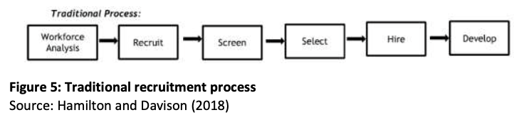
2.1 Hiring process
  What does it mean to hire employees? Hamilton and Davison (2018) provide a delineation of this conventional recruitment process in their paper “The search for skills: Knowledge stars and innovation in the hiring process”, detailing the steps involved in attracting and securing the right candidates for the job.
  The traditional recruitment process unfolds in six steps: It begins with workforce analysis to identify staffing needs, followed by recruitment efforts to attract candidates. Candidates are then screened to filter the applicant pool, after which the most fitting individuals are selected.
  Companies need to have a good understanding of the skills they are looking for. There might also be the need for foresight and prediction of future needs.
Exercise:
Take your company and think about the skills you might need in 2030 and in 2040. What kind of services will be offered, and which skills are necessary to deliver these services.
  Employer might want to know which persons to hire and how the future performance can be predicted (Tambe et al., 2019). This is itself biased as performance is an imperfect score and depends on historical data which is often incomplete and distorted. In addition, employers might be hesitant or even legally prohibited to use social media data.

Slide 17
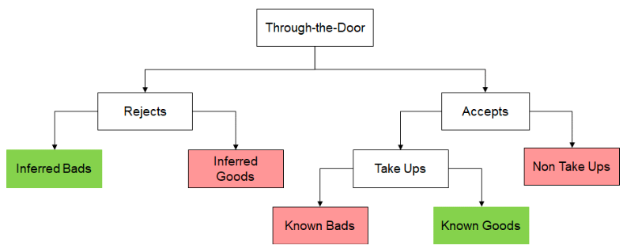
2.2 Digital Transformation in Recruitment
The figure below shows the logic adapted from the lending business. You want that the applicants accept your job offer and you only reject those applications which you do not deem good enough.
The digital transformation in recruitment has changed the way companies attract, evaluate, and hire talent. In general, the recruitment process has become more efficient
Two key components of this transformation are Applicant Tracking Systems (ATS) and the use of social media and professional networks.
Social media and professional networks have become integral to modern recruitment strategies. Platforms like LinkedIn, Twitter, and Facebook are not only used for sourcing candidates but also for building a strong employer brand.
Social media enables recruiters to engage with potential candidates by participating in relevant discussions, joining professional groups, and sharing industry insights.
Clear and consistent communication is important for a positive candidate experience. Everyone appreciates being kept informed about their application status and the next steps in the hiring process. This includes acknowledgement of the receipt of applications, regular updates on the status of the application process and timelines.
It is important to maintain a positive candidate experience throughout the hiring process. That is similar to what software designers call the “User Experience”. It can help to enhance the company’s reputation but also increases the likelihood of candidates accepting job offers and referring others to the organization.

Slide 18
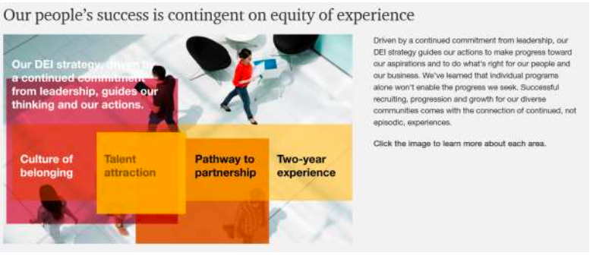
2.3 Compliance and Legal Considerations
  Labor laws protect workers’ rights and promote fair employment practices. During recruitment, companies must ensure compliance with these laws to avoid legal consequences and foster fairness.
  It is in the interest of the employer to have good contracts as conflicts are common and can cost significant amounts of money.
  For example, at PwC in the United States the DEI strategy is built around an equity of experience. DEI stands for diversity, equity and inclusion:
  Data privacy laws protect candidates’ personal information throughout the recruitment process. Companies must handle candidate data responsibly, collecting only necessary information and securely storing it with robust cybersecurity measures.
  Candidates must give informed consent before their data is collected, processed, or shared, and they should be informed of how their data will be used and protected. You might often notice all the little boxes you need to click in the recruiting process.
  Companies must also respect candidates' rights to access and delete their personal data, providing clear procedures for exercising these rights.
  Compliance with data protection regulations like the GDPR in the European Union is important, as these laws impose strict data handling requirements and significant penalties for non-compliance.

Slide 19
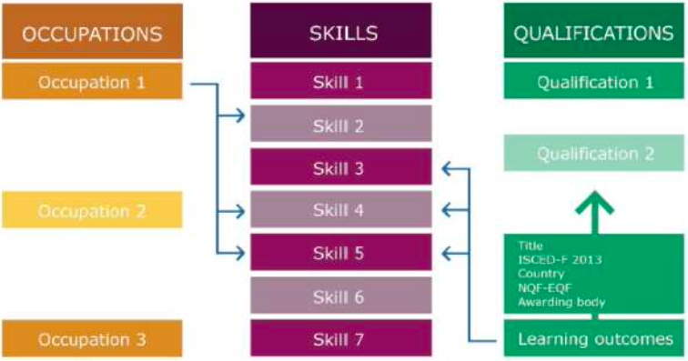
2.4 Occupations, skills and qualifications
The following illustration shows the links and relationships between occupations, skills and qualifications with skills in the middle. It shows that occupations require a set of skills. At the same time, skills are acquired through qualifications.
The ESCO classification has the following skills in the category information skills / documenting and recording information:
  conserve new media
  create semantic trees
  document seismic research
  document prior learning assessments
  ensure proper document management
  handle paperwork related to warehouse stock
  handle shipment paperwork
  log emergency call information electronically
  manage documentation of prior learning assessments
  operate mailing information systems
  record archaeological finds
  record lessons learnt from your sessions
  register information on arrivals and departures
  register visitors
In total, there are 13,485 skills comparable to this list. The occupations:
0. Armed forces occupations
1. Managers
2. Professionals
3. Technicians and associate professionals
4. Clerical support workers
5. Service and sales workers
6. Skilled agricultural, forestry and fishery workers
7. Craft and related trades workers
8. Plant and machine operators and assemblers
9.Elementary occupations
The list of assemblers has the following sub-categories:
82 - Assemblers
821 - Assemblers
8211 - Mechanical machinery assemblers
8212 - Electrical and electronic equipment assemblers
8219 - Assemblers not elsewhere classified
Figure 6: The link between Skills, Occupations and Qualifications
Source: European Commission (2018)

Slide 20
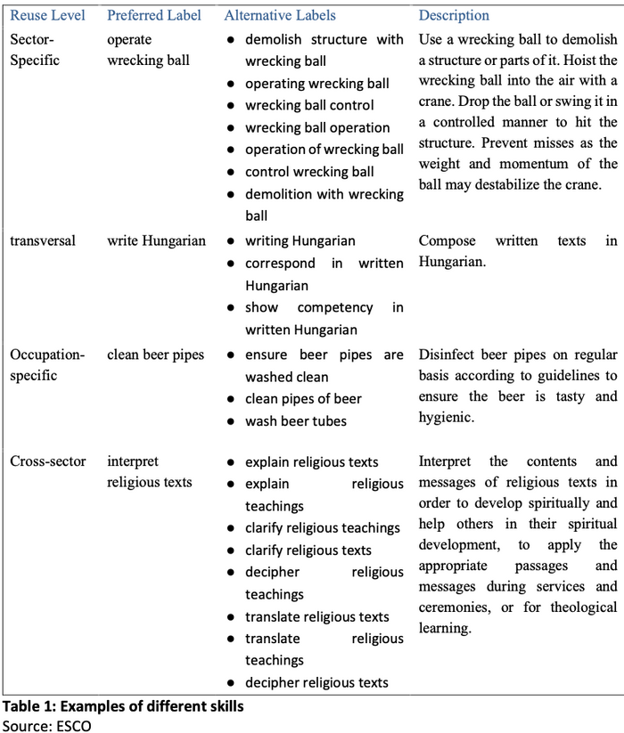
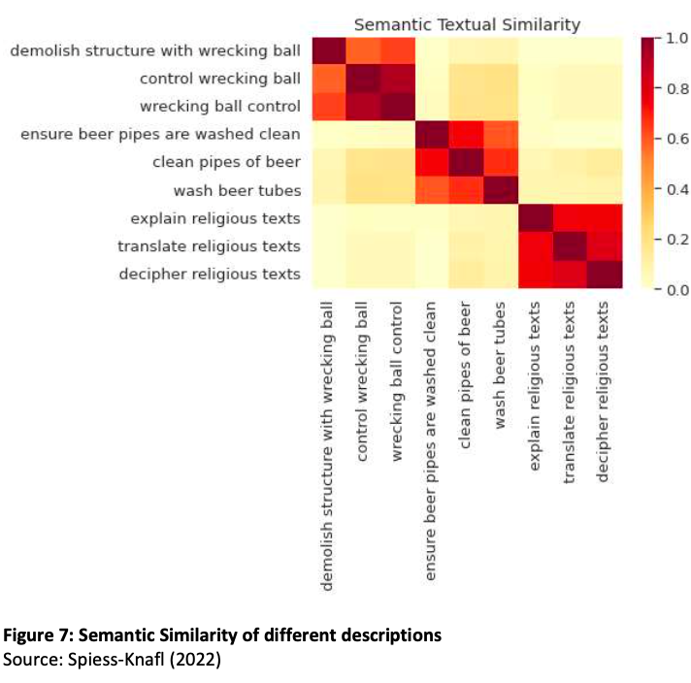
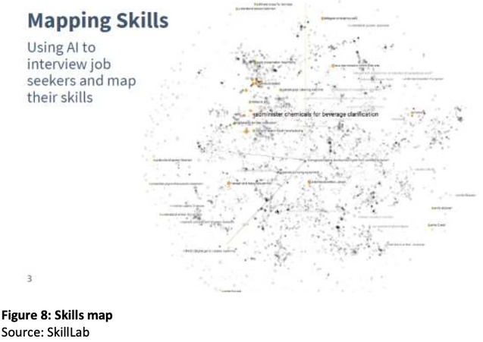
2.5 Skills
In general, skills are not clearly defined. For example, ESCO defines a “skills and competences” pillars which includes knowledge, skills and competences. Some examples are listed in the table below.
There are various options how artificial intelligence can be used to process the data. One way is using natural language processing tools.
One such tool is the Universal Sentence Encoder which can be used to analyze the semantic similarity between different skills (Spiess-Knafl, 2022).
This method visually represents semantic similarities through color-coded clusters, facilitating the clear identification of skills among applicants.
Another option is to identify an occupation which fits with the personal skill set. Companies which offer matching services use mostly natural language processing. SkillLab is a company which helps individuals to map their work experience into a set of clearly identified skills.
Once the model has identified a few dozen skills it can start suggesting occupations which require these skills.

Slide 21
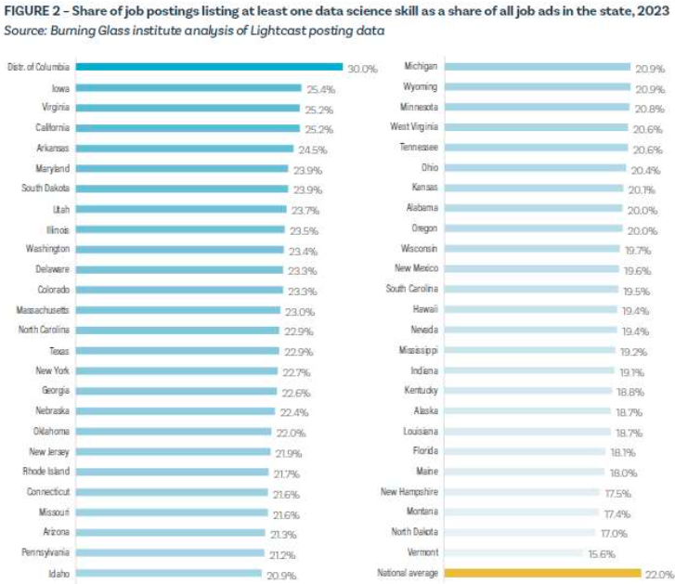
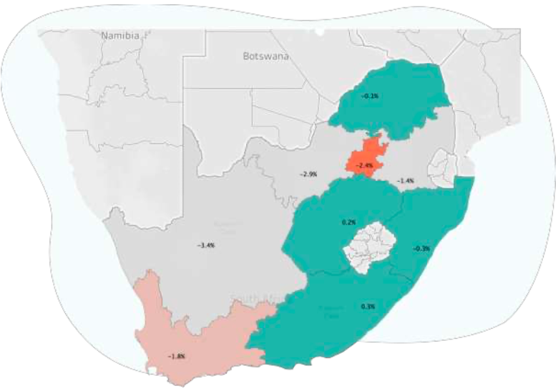
2.5 Skills
LinkedIn uses AI to analyze job postings and member profiles to identify in-demand skills and recommend relevant job opportunities. The platform leverages machine learning models and natural language processing to match skills with job requirements.
The Burning Glass Institute uses AI to analyze labor market data, providing insights into skill demands and job market trends. The models process large datasets of job postings to identify emerging skills and occupations.
In a recent report, they have looked at the share of job postings that have at least one data science skill.
Pymetrics uses neuroscience-based assessments and AI to match job seekers with suitable roles based on their inherent skills and attributes. The platform employs machine learning algorithms to analyze assessment data and predict job fit.
Faethm uses AI to forecast the impact of technology on jobs and identify the skills needed for the future workforce. The platform integrates machine learning and predictive analytics to model job transformations and skill requirements.

Slide 22
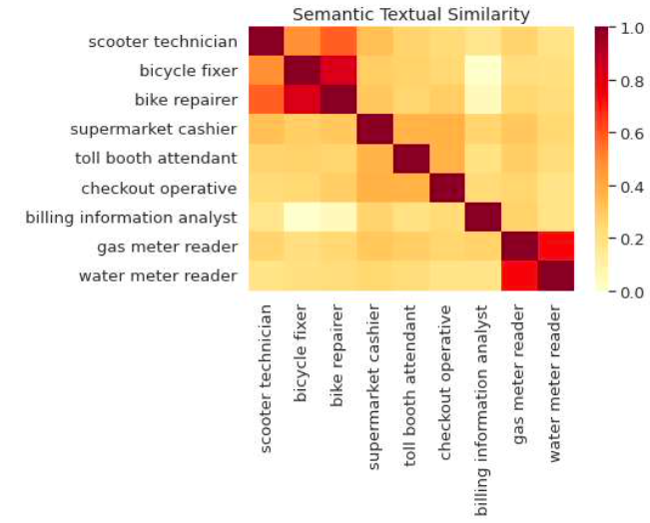
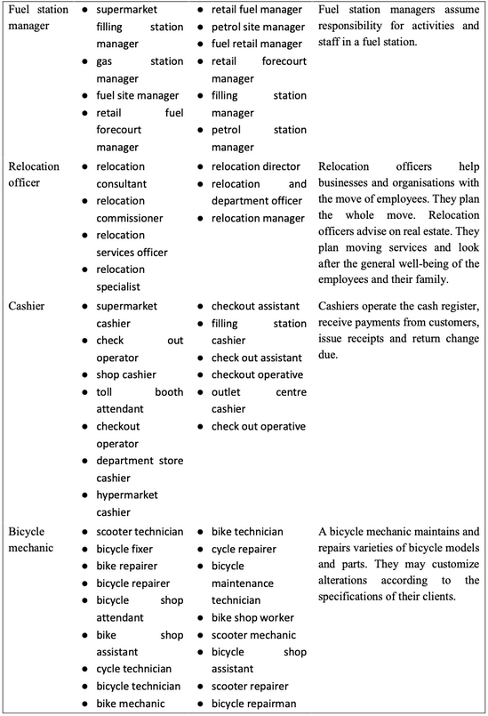
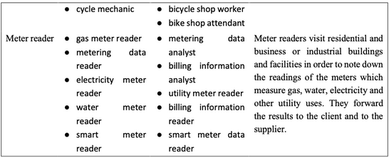

2.6 The other side: Occupations
Occupations are those activities where people spend most of their time pursuing a professional career. There are different approaches to defining occupations. The following table shows some examples of different occupations together with alternative labels and longer descriptions.
The following figure shows how semantic similarity tools classify similar occupations. The tool classified “scooter technician”, “bicycle fixer” and “bike repairer” correctly. However, for “supermarket cashier”, “toll booth attendant” and “checkout operative” it gave lower similarity scores.

Slide 23
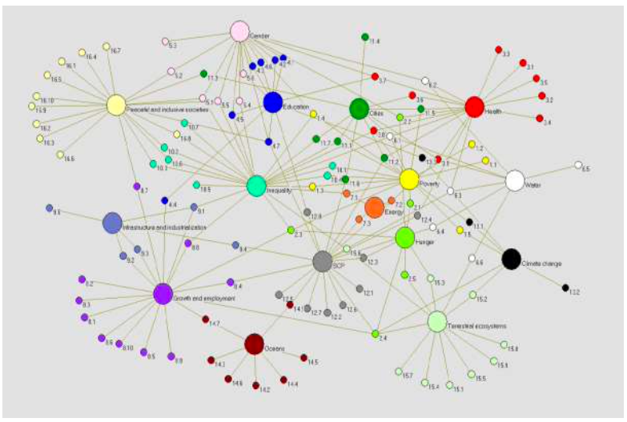
2.7 Education and qualification
The impact of education extends beyond academic achievement, influencing various socio- economic outcomes including poverty (Raffo et al., 2009), health (Ross & Wu, 1995), crime (Lochner, 2011) or even happiness (Oreopoulos & Salvanes, 2011) among others. Education thus impacts almost all other aspects of our daily lives.
Education plays a pivotal role in enhancing individual economic prospects, as evidenced by its strong correlation with earnings. Hanushek et al. (2015) find that a one-standard-deviation increase in numeracy skills increases earnings by 18 percent. Montenegro and Patrinos (2013) show that this positive correlation between education and earnings is not isolated to a single economy but is a consistent trend across 131 economies, underscoring the universal value of education. The cross-economy average is 10 percent per year of schooling.
The impact of education is also shown in the research mapping the different Sustainable Development Goals (SGDs) such as in the image. Education usually plays a central role as better education leads to better health, higher incomes and better lives for the next generation.
Education tied to a certain occupation is referred to as vocational education whereas general education is not related to any specific occupation. While vocational education is helpful for the transition into the labor market, there is also a risk for unemployment later in the career (Woessmann, 2016). Annabi (2017) discusses the productivity gains because of investments in education.
There is a strand of research discussing the role of credentials and qualifications for the labor market. A consensus is that credentials help to signal productivity and potential to employers. Brown and Souto-Otero (2020) analyze 21 million job advertisements and find that there is a greater emphasis on job readiness. Surprisingly, only one in five advertisements has listed minimum educational requirements.
Figure 10: The SDGs as a network of targets
Source: Blanc (2015)

Slide 24
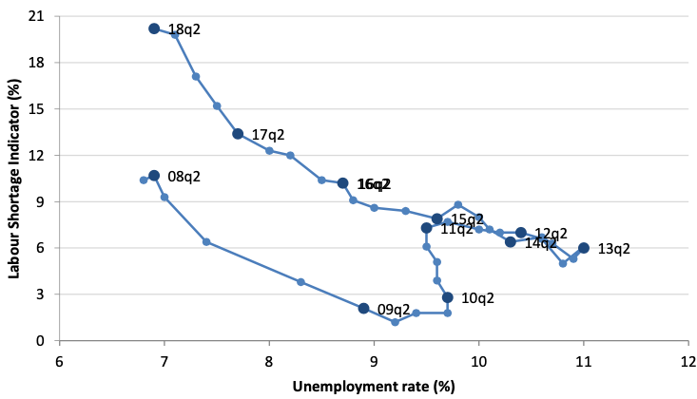
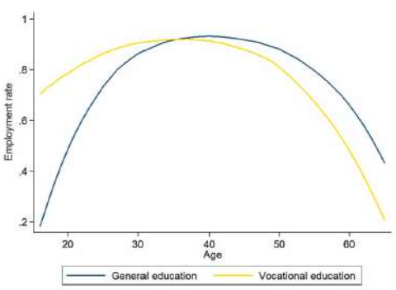
2.8 Mismatch
There is a mismatch between supply and demand in the labor market (Spiess-Knafl, 2018). The first number to look at is the number of job vacancies.
Across the European Union, there are 2.2% job vacancies with some variation between countries. While vacancies are higher in Germany (2.9%), the Czech Republic (4.8%) and Austria (2.8%) they are lower in Greece (0.7%), Spain (0.9%) and Poland (1.2%) as of the first quarter of 2018 (Eurostat 2018).
Job churn is at a record low even for the United States (R. Atkinson & Wu, 2017). Job churn is defined as the sum of the absolute values of jobs added in growing occupations and jobs lost in declining occupations.
Data from the European Commission (2018) illustrated in the Beveridge curve show that there is labor (i.e., skills) shortage but simultaneously low unemployment. That might lead to the conclusion that skills need to be more efficiently allocated among European companies. Moreover, skills need to be developed in life-long learning programs.
The low rate of job losses might be explained by the dynamics of the economy and the development of job portfolios.
Each job requires thus a number of skills. There are two ways to estimate wages, and both are related to skills. Thousands of studies are based on Mincer (1974) which links wages to years of schooling and experience.
A recent study by Montenegro and Patrinos (2014) found that the cross-economy average rate of return is around 10% per year of schooling. Those studies are based on easily accessible and observable schooling data. Hanushek et al. (2015) use data from the PIAAC (Programme for the International Assessment of Adult Competencies) and show that a one-standard-deviation increase in numeracy skills (based on a normalized data set) is associated with an 18% wage increase among workers.
The development of skills remains an issue as shown by the lifetime employment of persons educated in different systems. A vocational system might bring benefits earlier in the career but results in higher unemployment later in life as shown in the following figure.
The higher unemployment for persons educated in the vocational systems underlines the need for life-long learning.
Figure 2: Beveridge curve 2008-2018 – European Union
Source: European Commission (2018)
Figure 3: Education Type and Life-Cycle Employment in Denmark, Germany and Switzerland
Source: Hanushek et al. (2017)

Slide 25
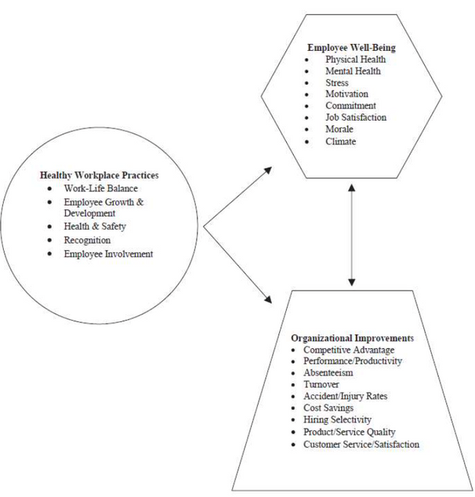
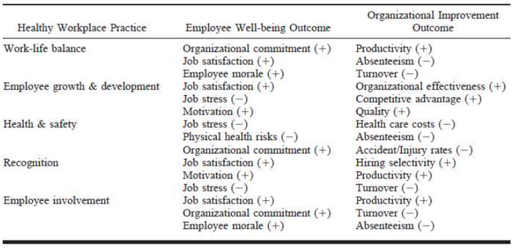
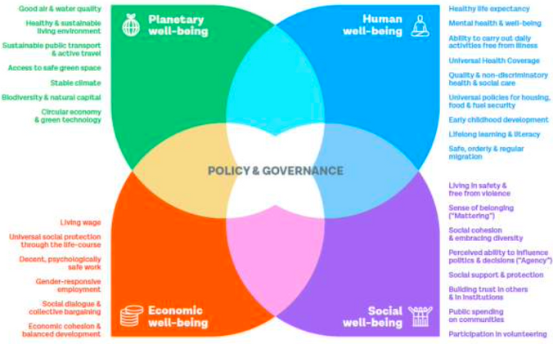
2.9 Workplace Well-Being
Dimensions important for workplace well-being:
  The best use of time
  Working Conditions
  Supervision
  Promotional opportunities
  Recognition of good performance
  Appreciation as an individual at work
  Wages
  Job security
Measuring employee well-being can be accomplished through various methods.
Commonly used instruments include the Gallup National Health and Well-Being Index for the United States and the WHO-5 Well-Being Index.
The WHO published a paper in 2023 on “Harnessing the benefits of well‐being policies and investments for health”.
There is a good argument that a healthy workplace leads to various benefits as shown in the PATH model by Grawitch et al. (2006).
There is a good argument that employees which like to go to work will have lower levels of sick leave, lower turnover rates or show a higher satisfaction with their job.
Beyond that, there are also cynical approaches which consider a large share of our existing jobs as “bullshit jobs”. This was a popular argument outlined by the late David Graeber (2019).
To improve employee well-being, several companies are utilizing artificial intelligence (AI).
Table 3: Examples of the Relationship Between Healthy Workplace Practices, Employee Well-Being, and Organizational Improvements
Source: Grawitch et al. (2006)
Figure 11: Dimensions of well-being
Source: WHO (2023)
Figure 12: Path model
Source: Grawitch et al. (2006)

Slide 26
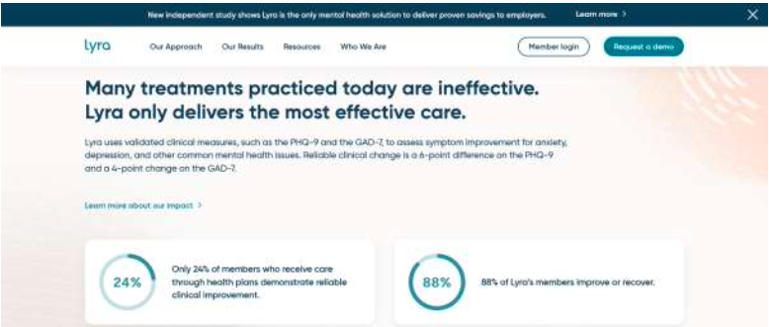
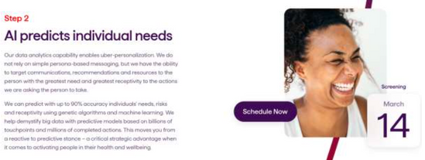
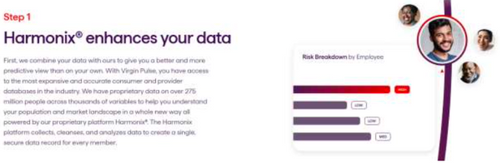

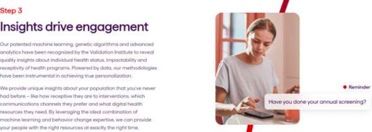
2.9 Workplace Well-Being
Lyra Health uses artificial intelligence to provide personalized mental health care solutions to employees. Their platform connects users with therapists and coaches.
Virgin Pulse uses AI to promote holistic employee well-being through personalized wellness programs, including physical activity tracking, nutrition advice, and mental health resources. Their AI platform analyzes user data to create customized wellness plans that align with individual health goals and preferences.
In a second step, they use artificial intelligence to predict individual needs.
In a first step, they need to access corporate data.
They also offer a platform where employees can access the services.
In a third step, they use artificial intelligence to drive engagement.
On their website, they offer a description:
“Lyra takes the guesswork out of finding the right provider. When members begin their search, our artificial intelligence (AI) matching technology immediately matches them with providers who specialize in their clinical needs.”

Slide 27
3. Predicting performance and workforce management
Objectives:
  Learning how AI is used in performance prediction by understanding how AI tools are used to forecast employee performance and workforce needs
  Exploring AI's role in workforce management by discovering how AI optimizes scheduling, monitoring and engagement to improve workforce efficiency

Slide 28
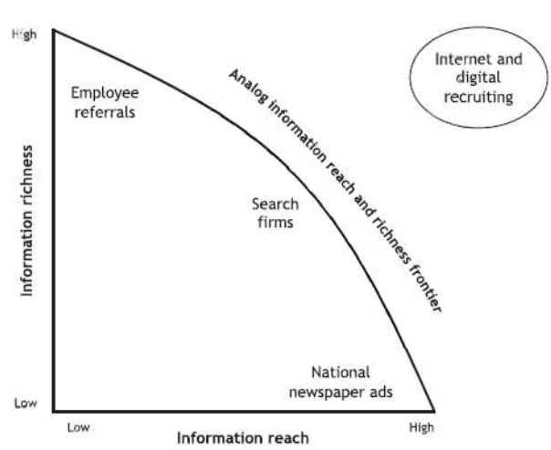
3.1 Introduction
  One of the key issues is to synchronize the needs of the economy and the skills of the younger generation. The focus of this discussion is how artificial intelligence tools may help in the selection of applicants.
  That has become a lot easier with the emergence of new digital tools. These tools have expanded the relationship between information reach and information richness as illustrated in the figure below.
  At the other side, individuals want to understand which skills are relevant for their future work biography. There is a large body of literature which covers the career-making decisions of individuals.
  Recent years have seen dynamic changes driven by technological change (Autor et al., 2003). In an interesting research paper, Borbély-Pecze (2020) has analyzed the changing relationship between individuals and their job in the case of Hungary.
  There are many companies offering psychological surveys and trying to match psychological profiles with potential jobs. Journeys is another concept which illustrates career paths to students and maps it for them.1
Figure 13: Analog information reach and richness frontier
Source: Black and van Esch (2020)
1 https://journeysmap.com/

Slide 29
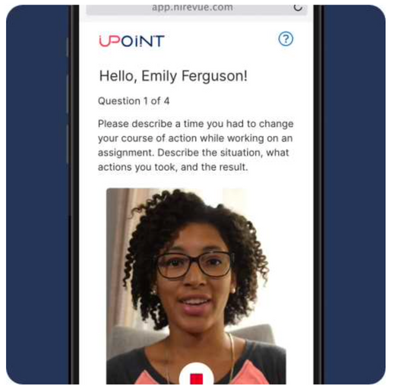
3.2 Perspective of Employers
Employers are tasked with assembling and sustaining a workforce that is both skilled and efficient, a responsibility that encompasses both hiring new talent and overseeing existing employees, commonly referred to as talent acquisition and talent management.
The core of this process involves pinpointing the specific skills and roles that are currently lacking within the organization, which then informs the creation and dissemination of job advertisements.
There are many applications which evaluate the performance of employees. Brown, Burke, and Sauciuc (2021) discuss the benefits of integrating artificial intelligence in performance evaluation systems. The main argument to implement these tools is that the idea that AI reduces the level of bias in these evaluations. Altemeyer (2019) discusses business cases where machine learning tools were used to select the best employees in the past and automatically identify similar applicants.
HireVue has already delivered 22 million job interviews where applicants can submit videos which are then analyzed automatically. They explain their use of AI in the following way:
At HireVue, we use static algorithms because that is the best way to provide fair and similar treatment for all candidates. We believe that algorithms should be highly controlled and tested by experts (Occupational Psychologists and Data Scientists) throughout the entire lifecycle of the model. As such, they can then help to reduce hiring bias and make the process fairer. We deploy AI that is both static and deterministic, meaning algorithms are not being re-trained or “learning” on the fly and they provide a repeatable output each time they are used; this should be the standard in hiring. With our AI systems, the algorithm is trained and tested in the “lab” and then locked before deployment. The system can only “learn” new things if someone chooses to update it.
HiredScore is another example. It stresses diversity and inclusion and promises to increase both. It is a concept for companies with many applications (more than 500,000 per year). HiredScore uses advanced AI-based algorithms to screen, rank, and match candidates to open positions based on their qualifications, experience, and fit for the company. This reduces the manual data handling involved in the hiring process. Their algorithms can also help in identifying talent within internal databases, existing employees, or those in talent pipelines.
The company is claiming that that their system is designed to reduce unconscious bias in hiring decisions by focusing on skills and qualifications rather than demographic data. In practice, they ignore factors that could introduce bias (e.g., gender, ethnicity) and instead focus on relevant qualifications and job criteria. However, as we will discuss in more detail in the last chapter, there are many other aspects which point towards gender and ethnicity. It is relatively easy to identify the gender or ethnicity using the address, mandatory service in the military, sports activities or foreign languages.

Slide 30
3.3 Other institutions
There are many intermediaries which are in the field such as job platforms or labor market agencies, whose primary function is to align skills with job opportunities. These entities are repositories of vast data, which they leverage to discern skills. oca (2019) introduced a model that uses the extensive skill dataset on LinkedIn, demonstrating the essential role of big data in navigating the complexity and diversity of skills.
Authorities are keen on comprehending the skill landscape through extensive surveys to inform their strategies and resource allocation
Austrian labor market agency
JET
AI4Belgium
The Austrian labor market agency implemented an algorithm which was basically classifying job seekers in three categories depending on the probabilities of finding a job within a certain period of time (Allhutter et al., 2020). The model had four types of job seekers:
  Job seekers with a complete historical employment record of 4 years prior to model generation
  Job seekers with an incomplete or “fragmented” employment history
  Job seekers with a “migration background”
  Young adults
Despite its potential, especially in identifying and assisting vulnerable groups like NEETs and marginalized individuals, such a system faced limitations due to concerns around privacy and legitimacy, leading to its short-lived operation.
Parallel initiatives, such as the Jamaican Youth through Empowerment & Training (JET) program, demonstrate the utility of AI in pinpointing marketable skills, thereby enabling targeted training for youths.
This analysis enabled the program to tailor training programs in digital, entrepreneurial, and soft skills to meet the specific needs of 1000 youths aged between 17 and 34 (Trust, 2022).
The initiative gather data from open-source platforms such as social media platforms, websites, and job portals to analyze in real time and identify the needed skills in the Jamaican labor market.
The AI4Belgium strategy by the Belgian government is another example of such initiatives as it is leveraging AI for effective labor market demands. With a goal to maximize the opportunities of AI, the Belgian government invested in various AI-driven programs and initiatives, such as promotion AI education, training, and research programs, as well as attracting and retaining
AI experts and professionals (Government of Belgium, 2019). As part of the investment, the collaboration between the government employment agency and FARI (AI for the common good), an institute in Brussels led to the incorporation of AI in the job- matching process to provide employment solutions to both job seekers and employers. (FARI, 2022)

Slide 31
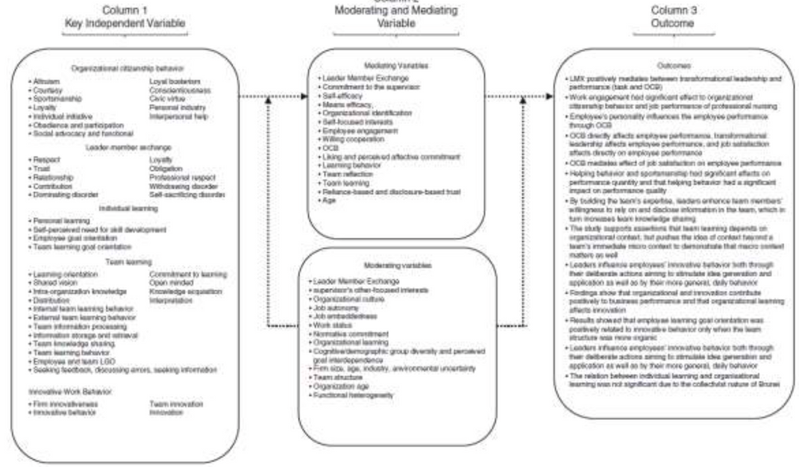
3.4 What is performance?
Employee performance refers to the effectiveness with which job responsibilities are carried out and goals are achieved. It encompasses a range of behaviors and outcomes that contribute to organizational success.
Key components of employee performance include task performance, which involves the execution of job-specific duties, and contextual performance. Additionally, it might include adaptive performance, which is the ability to respond to change, and proactive performance, which involves anticipating and acting on future needs.
Systematic literature review carried out by Atatsi et al., (2019) shows how different aspects are related to each other:
Key Performance Indicators (KPIs) are essential for measuring employee performance and vary depending on the role and organizational goals. Common KPIs include:
  Productivity: Measures the output of an employee relative to input, such as hours worked or resources used.
  Quality of Work: Assesses the accuracy, thoroughness, and effectiveness of the work performed.
  Efficiency: Evaluates the ability to maximize output with minimal waste of time and resources.
  Customer Satisfaction: Gauges the level of satisfaction customers have with an employee's service or product.
  Attendance and Punctuality: Tracks the consistency and reliability of an employee's presence at work.
  Goal Achievement: Measures the extent to which an employee meets or exceeds predefined goals and targets.
Important internal factors:
Internal factors play a crucial role in determining employee performance within an organization. One of the most significant factors is the skills and competencies that an employee brings to their role.
Motivation is another vital internal factor.
Health and well-being, both physical and mental.
The work environment significantly affects performance.
Organizational culture.
Leadership is another critical external factor.
Economic conditions also play a significant role in employee performance.
Technological advancements are another crucial factor affecting performance.
Figure 14: Relationship
Source: Atatsi et al. (2019)

Slide 32
3.5 AI-Based Performance Evaluation
Artificial Intelligence (AI) is revolutionizing performance evaluation by offering advanced tools and techniques that enhance traditional methods. Traditional performance evaluation methods often rely on periodic reviews and subjective assessments, which can be time- consuming and prone to biases. In contrast, AI-based approaches leverage data-driven insights and continuous monitoring to provide more accurate, objective, and timely evaluations.
Claus & Briscoe (2009) have analyzed performance management systems across borders which was mostly centered around expatriates.
Researchers in psychology departments have analyzed how individuals react to incentives (e.g., Ariely et al., 2009; Bareket-Bojmel et al., 2017). Accounting researchers have found that there is an optimal interval for reporting employee performance (Hecht et al., 2020).
Another limitation is the resistance to change.The introduction of AI-based systems can be perceived as intrusive, with fears of surveillance and potential job displacement.
Interpretability of AI models is another critical concern. All AI models based on neural networks and particularly those that are complex, can be impossible to interpret. This lack of transparency can make it challenging to understand the rationale behind specific evaluations and predictions. Without clear explanations, it becomes hard for managers and employees to trust and act on the AI's insights.
Predictive analytics leverages AI and machine learning algorithms to forecast employee performance and potential. These tools analyze historical data and identify patterns that can predict future outcomes. For example, predictive analytics can identify high-potential employees, anticipate performance dips, and suggest targeted interventions to address specific issues.
Modern performance management systems integrate AI to streamline and enhance the evaluation process. These systems often include features such as continuous feedback mechanisms, goal tracking, and real-time performance analytics. AI-powered tools can analyze vast amounts of data from various sources.
One of the primary challenges is data quality and availability. AI systems rely on high-quality, comprehensive data to generate accurate predictions. If the data is incomplete or biased, it can lead to erroneous conclusions, undermining the reliability of the AI's assessments. Therefore, ensuring the integrity and completeness of the data is critical for the success of AI- based performance prediction systems.
Privacy concerns also pose a significant challenge. The collection and analysis of detailed performance data raise important privacy issues. Organizations must implement transparent policies and robust data protection measures to safeguard employee information.
Utilizing predictive analytics in the realm of employee performance offers numerous advantages that can significantly enhance organizational effectiveness. One of the primary benefits is talent identification. Predictive models can analyze various data points to identify employees with high potential for leadership roles or specialized tasks.
Performance improvement is another application of predictive analytics.
Succession planning is also greatly enhanced by predictive analytics.
Predictive analytics enables personalized development plans for employees. By leveraging AI to analyze individual strengths and areas for improvement, organizations can create tailored development plans that are more effective and engaging.

Slide 33
3.6 Workforce Management
Workforce management (WFM) is a set of processes used by an organization to optimize the productivity of its employees. This involves forecasting labor requirements, creating and managing staff schedules, tracking attendance, and ensuring compliance with regulations.
Workforce management involves a wide range of key components that are essential for aligning an organization's human resources with its broader objectives.
Strategic Workforce Planning ensures that the workforce is aligned with organizational goals, helping to maintain the right number of employees with the necessary skills. This is closely followed by Talent Acquisition and Development, which focuses on recruiting, hiring, and training employees to meet both present and future workforce needs.
Another element is Performance Management, which involves monitoring and evaluating employee performance to promote continuous improvement and support the achievement of organizational targets. Employee Scheduling is also important for manufacturing or service provision companies, as it ensures that work schedules are optimized to make the most of available labor resources while also accommodating employee preferences and availability.
Compliance Management is essential to ensure that the organization adheres to labor laws and internal policies, reducing the risk of legal complications and fostering a culture of fairness. Lastly, Employee Engagement plays a key role in maintaining a motivated, satisfied, and committed workforce through the implementation of strategies that foster a positive work environment.
These components collectively form the foundation of effective workforce management, contributing to an organization's overall success.
AI is playing an increasingly pivotal role in workforce management by automating various processes and delivering valuable data-driven insights.
One of the most powerful applications of AI is in Predictive Analytics, where AI algorithms forecast labor demand and highlight potential skill gaps, allowing organizations to plan their workforce needs proactively. Additionally, Automated Scheduling uses AI-powered tools to generate optimal work schedules that not only maximize productivity but also respect employee preferences and adhere to legal requirements.
In terms of Employee Monitoring, AI systems can track performance metrics in real time, offering managers actionable insights that can be used to boost productivity. Talent Acquisition also benefits from AI, as it can streamline the recruitment process by efficiently screening resumes, assessing candidates, and predicting their job fit.

Slide 34
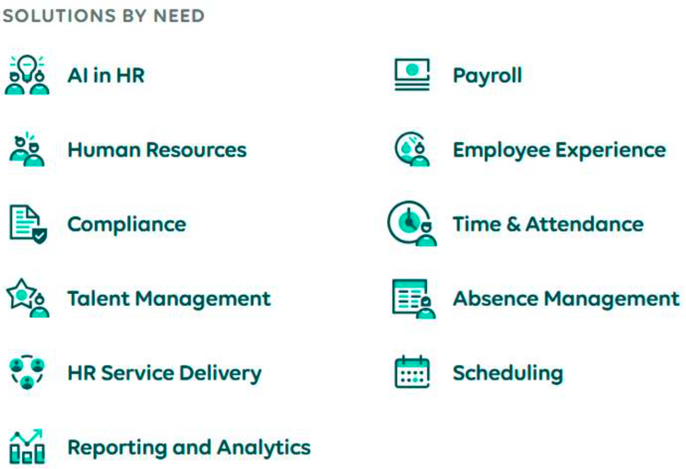
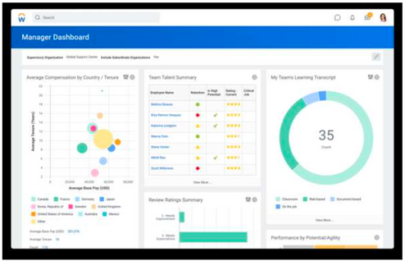
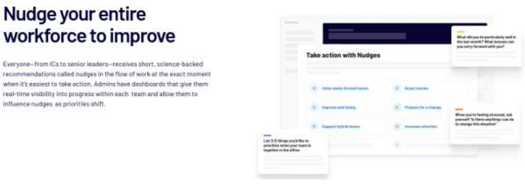
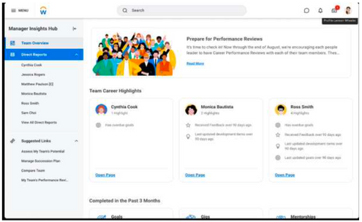
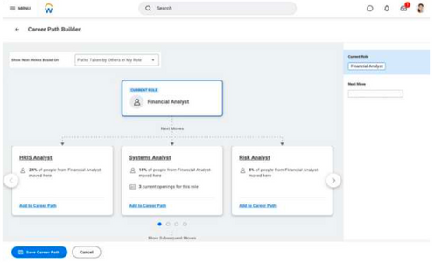
3.7 Companies using AI to manage the workforce
UKG
A typical company that offers many different solutions. The company employs AI to optimize workforce management solutions, including timekeeping, scheduling, and employee engagement. It uses AI to analyze historical labor data, predict staffing needs, and create optimized schedules that align with business demand. Their AI tools also help in monitoring employee attendance and productivity, providing insights to improve workforce efficiency:
Workday
The company incorporates AI and machine learning into its human capital management (HCM) suite to improve performance management and employee development. Its algorithms evaluate performance data continuously, providing real-time feedback and recommendations.
The platform also uses predictive analytics to forecast employee performance and identify potential leaders. For managers, they offer dashboard such as the ones below:
Humu
A company that employs AI to drive behavioral change and improve employee performance through personalized "nudges" based on performance data.
They analyze performance data and uses behavioral science to send personalized nudges that encourage positive actions and habits.
These nudges are tailored to individual needs and organizational goals, enhancing overall performance.
Below is one such example:

Slide 35
4. Increasing performance and efficiency
Objectives:
  Understanding techniques for measuring performance by learning about various methods such as Key Performance Indicators (KPIs) and AI-based tools used to assess both individual and team performance.
  Exploring how AI can help to improve efficiency by discovering how AI-driven solutions enhance workplace efficiency through automation, real-time analytics, and optimized resource management.

Slide 36
4.1 Introduction
Performance
Performance within an organization refers to the execution of job duties and responsibilities, as well as the achievement of organizational goals and objectives. It encompasses a wide range of behaviors, activities, and outcomes that contribute to the effectiveness and success of the organization.
Key Performance Indicators (KPIs) are critical metrics used to measure performance across various departments. These indicators differ depending on the department and its specific objectives. Some indicators include:
  Sales: Sales revenue, conversion rates, customer acquisition cost.
  Marketing: Brand awareness, lead generation, return on marketing investment.
  Human Resources: Employee turnover rate, time to fill positions, employee satisfaction.
  Operations: Efficiency, quality control, on-time delivery rate.
  Finance: Profit margins, return on investment, budget variance.
It shows that performance is different across different domains and functions within a company. Each unit should thus identify and track the KPIs most relevant to its strategic goals to ensure that performance is measured accurately and improvements can be made where necessary.
Performance can be evaluated at both the individual and team levels.
  Individual Performance: This involves assessing an employee’s specific contributions to their job role. Factors such as productivity, quality of work, and adherence to deadlines are commonly evaluated. Performance reviews, self-assessments, and peer reviews are typical tools used for individual performance evaluation.
  Team Performance: This focuses on how well a group of employees works together to achieve common goals. Key metrics for team performance include team productivity, collaboration, innovation, and collective problem-solving abilities. Successful teams often exhibit strong communication, mutual support, and synergy.
Evaluating both individual and team performance helps organizations to identify high- performing employees and teams, provide targeted feedback, and foster a culture of continuous improvement. Effective leadership plays a pivotal role in aligning individual and team performance with organizational objectives, thereby enhancing overall performance.

Slide 37
4.2 Techniques for Measuring Performance
To accurately assess performance, a variety of methodologies and tools are employed.
Performance appraisal
360-degree feedback
KPI’s
Balanced scorecard
Benchmarking
One commonly used method is the performance appraisal, where managers regularly evaluate an employee's performance based on predefined criteria. This helps identify strengths and areas for improvement.
Another effective approach is the 360-degree feedback system, which gathers comprehensive feedback from multiple sources, including an employee's peers, subordinates, supervisors, and the employee themselves through self-assessment. This holistic approach provides a more complete picture of performance.
In addition to qualitative evaluations, quantitative methods such as Key Performance Indicators (KPIs) are essential. These metrics allow organizations to measure how effectively an individual, team, or the company as a whole is achieving critical business objectives
Another strategic tool is the balanced scorecard, which offers a broader perspective by evaluating performance across multiple dimensions, such as financial results, customer satisfaction, internal processes, and growth and learning opportunities.
Benchmarking is another valuable technique, enabling organizations to compare their performance against industry standards or best practices. This comparison helps pinpoint areas where the organization can improve, driving continuous growth and development.

Slide 38
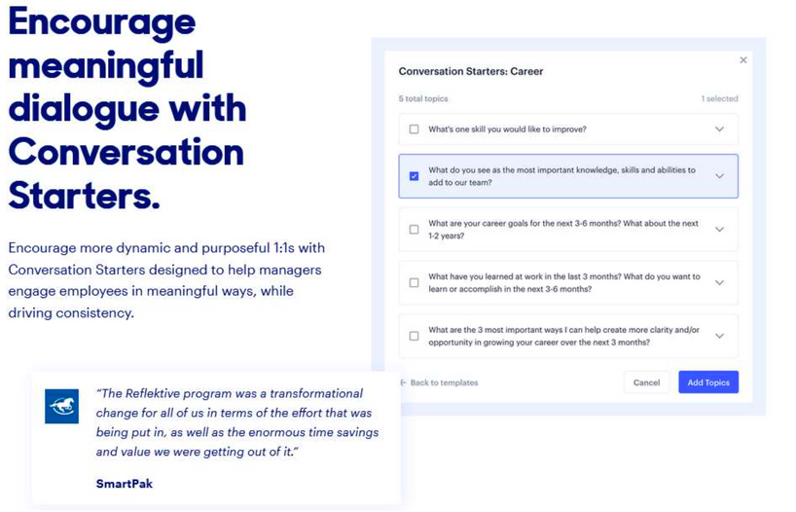
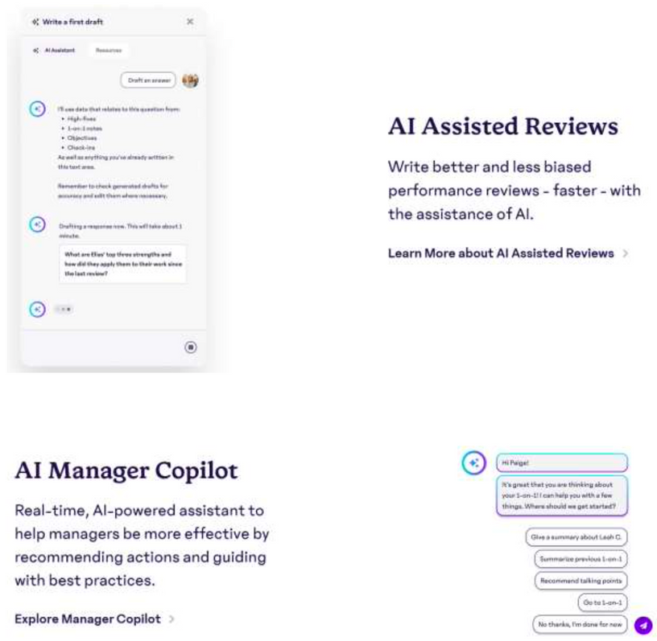
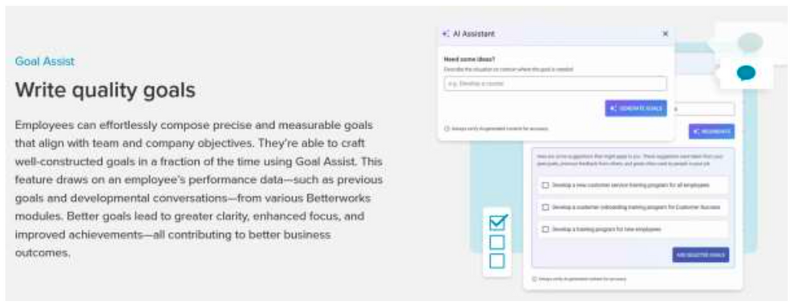
4.3 Companies using AI to increase performance
Artificial Intelligence (AI) is impacting how organizations measure and predict employee performance, providing advanced tools and techniques for more accurate, objective, and real- time evaluations.
15Five is a typical example how artificial intelligence can be used to improve operational performance. They are helping to write reviews or prepare 1:1 conversations with team members.
Reflektive (https://www.reflektive.com/) which also uses continuous performance management and real-time feedback. Similarly, they offer support for 1:1s. It’s not entirely clear which managers need questions for interactions but it is surely helpful to have some back-up questions.
Betterworks uses AI to help organizations across various dimensions. For example, they provide assistance in writing goals or improve performance reviews.

Slide 39
4.4 What is Efficiency?
Efficiency means “Doing things right”. It focuses on the process and measures how well resources are used to achieve outputs. An efficient process minimizes waste and maximizes resource utilization.
Technological advancements play a significant role in enhancing workplace efficiency by automating tasks, streamlining processes, and improving resource allocation. Automation reduces manual labor and errors by using software and robotics to perform repetitive tasks. Workflow management systems further optimize business processes, leading to better coordination and increased efficiency. Data analytics helps identify inefficiencies and allows for more informed decision-making, resulting in better operations overall.
In terms of resource allocation, resource management software ensures that resources are effectively assigned based on availability and project needs. Capacity planning ensures that resources are available and used efficiently to meet future demands, helping organizations remain responsive to changing conditions.
Effective time management also contributes to increased efficiency. Prioritization ensures focus on high-impact tasks that align with organizational goals, while time-blocking allows for dedicated periods of focus on different activities, enhancing productivity. Additionally, automating routine tasks frees up time for more strategic efforts, reducing distractions and allowing employees to focus on more critical work.
Effectiveness means “Doing the right things”. It focuses on the outcome and measures the extent to which objectives are achieved. An effective process delivers the desired results, regardless of the resources used.
Both efficiency and effectiveness are important elements for organizational success. While efficiency ensures resources are not wasted, effectiveness ensures that the goals and objectives are met. Balancing both is key to optimal performance.
Efficiency in the workplace refers to the ability to accomplish a task or achieve a goal with the least amount of resources, time, and effort. It is a measure of how well resources are used to achieve desired outcomes with minimal waste. Efficient organizations can produce higher outputs with fewer inputs, leading to better profitability and sustainability.

Slide 40
5. Decision-making support
Objectives:
  Understanding the structure of scripts and workflow in companies by learning how scripts are designed and implemented to automate tasks and streamline workflows within organizational structures.
  Exploring the development of AI agents in workflow management by discovering how AI agents optimize workflows by monitoring real-time data, predicting potential bottlenecks and enabling efficient task routing.

Slide 41
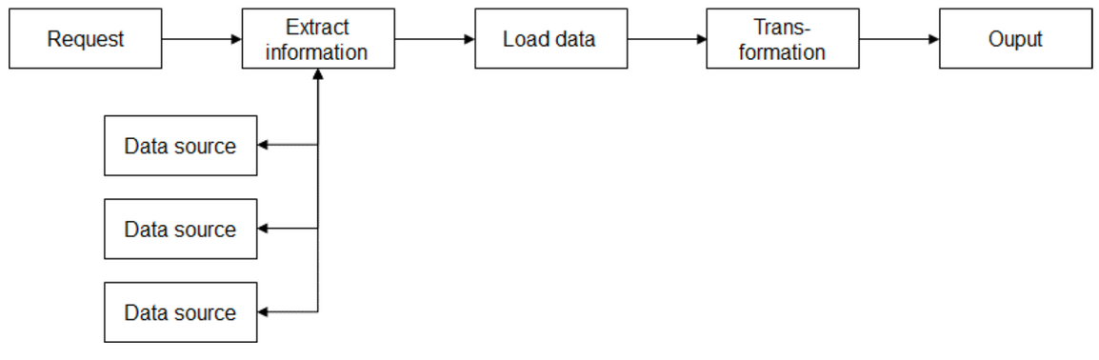
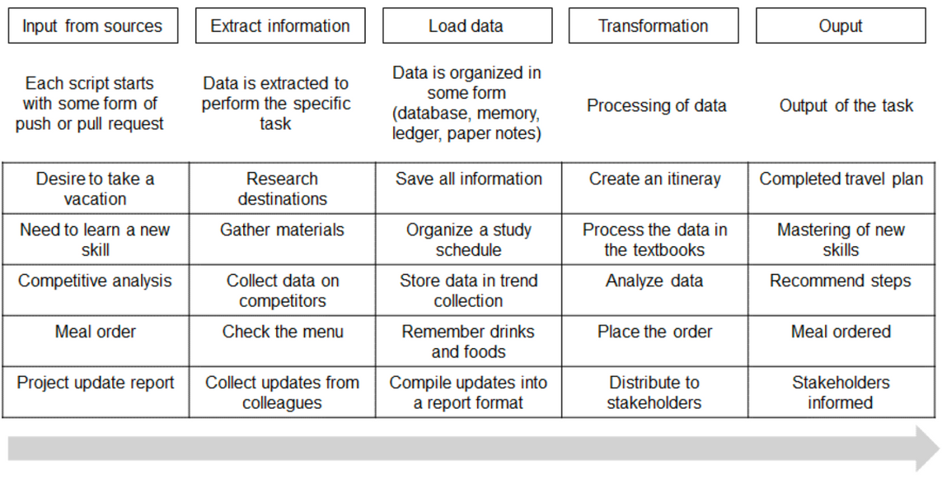
5.1 Introduction
This chapter covers the decision-making support for employees. The complexity of tasks and how they are managed has evolved significantly over the past decades, largely due to advancements in technology and changes in business practices.
Comparison of Task Complexity:
  1950s: Tasks were predominantly manual, and paper based.
  1990s: The advent of personal computers and early software applications started to automate some tasks.
  2000s – 2010s: The rise of the internet and enterprise software like ERP (Enterprise resource planning) systems led to greater integration and automation of business processes. Cloud computing started to gain traction.
  Today: Modern workflow management systems are highly integrated, leveraging cloud computing, and increasingly artificial intelligence to automate complex processes. Real-time data analytics and IoT devices provide continuous insights and optimization opportunities. Decision-making is becoming more decentralized and we will start to see AI agents which will be assisting in real-time, data-driven decisions.
ELT (Extract, Load, Transform) to describe the structure of scripts:
The tasks described above are also much stronger linked than before. Scripts often need to pull data from other sources to complete their tasks. This might be relatively straightforward for many topics, but it becomes incredibly complex for other areas.

Slide 42
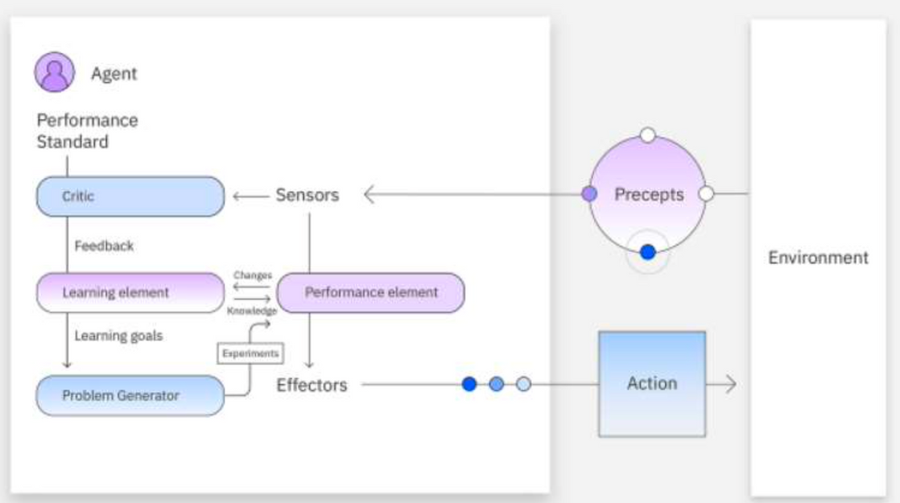
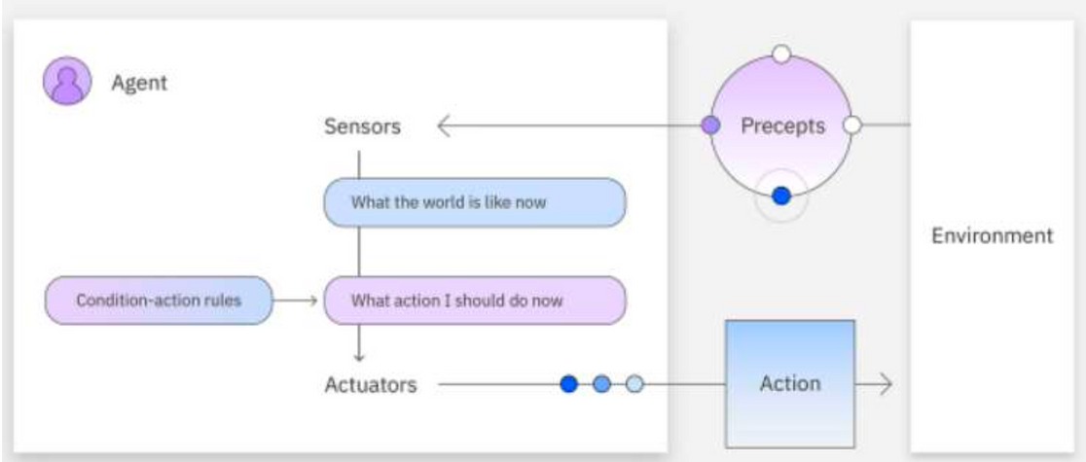
5.2 Decision-making support and the development AI agents
Modern workflow management systems are designed to execute and automate scripts efficiently, ensuring that business processes are carried out smoothly and with minimal human intervention. Scripts in this context refer to predefined sequences of operations or tasks that are triggered by specific events or conditions. These systems automate repetitive tasks, manage approvals, and route tasks to the appropriate personnel or departments.
AI-based tools can automate complex decision-making processes by evaluating multiple criteria and selecting the best course of action. For example, in financial services, AI can automatically approve or reject loan applications based on predefined risk parameters.
This leads to the development AI agents.
An agent refers to something that takes certain action. A very simple agent would be the heating system in your house. Whenever the temperature is below a certain temperature, it would start heating the house.
A more complicated AI agent could have the structure as shown below. This AI agent would even have the ability to learn and it called a learning agent. It consists of four elements as described by IBM:
  Learning: This improves the agent’s knowledge by learning from the environment through its precepts and sensors.
  Critic: This provides feedback to the agent on whether the quality of its responses meets the performance standard.
  Performance: This element is responsible for selecting actions upon learning.
  Problem generator: This creates various proposals for actions to be taken.
AI agents are software programs designed to perform tasks autonomously by mimicking human decision-making processes. These agents rely on machine learning algorithms, natural language processing, and other AI technologies to analyze data, learn from it, and act on it.
Exercise: Think of a use case in a company which you know well. What kind of work can be taken over by such learning agents?

Slide 43
5.3 Industry cadence
It is a bit of a side note, but it is also important to keep in mind how fast an industry operates. Byrne Hobart described the following observation:
It's popular to say that every company is becoming a tech company, and to some extent that's true. But companies need to be judicious about evolving towards sectors of the economy that operate on a faster cadence than they're used to.
Some industries are operating on a very slow schedule. A typical fashion retailer needs to order stock for the fall season probably 6-8 months earlier. This makes sense: Textiles need to be ordered, factories scheduled and shipping container booked.
Think of the airline industry or space agencies which need decades to develop new airplanes or rockets.
Some fashion companies are now producing on much shorter schedules. Zara has cut the production time to 2-3 weeks, while the total production time from concept to final product is 2-3 weeks for Shein.
Some software companies are able to change their codebase in a matter of hours and quickly ship it to their customers.
There are many areas where the instantaneous availability of data has led to a sharp reduction in the time to complete a cycle (however it is defined). However, it is not clear that an increase in the cadence of an industry increases the complexity (especially when tasks are becoming more digital at the same time).

Slide 44
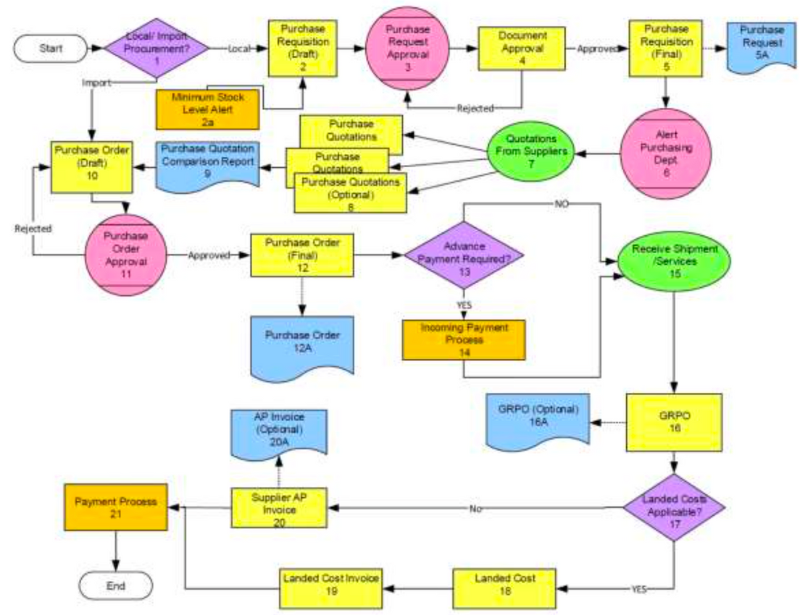
5.4 Examples for software solutions
The German company SAP is one of the leading enterprise resource planning (ERP) systems globally, used by more than 425,000 companies across various industries. SAP provides comprehensive solutions for mapping, managing, and optimizing business processes. The company offers modules for finance, human resources, supply chain and sales among others.
Why is it needed? Take a look at the following business process map which is fairly typical for processes in companies.
For local procurement, when the required good is available locally, the process starts with drafting a purchase requisition, which is then submitted for approval. Upon approval, a purchase order is issued to the supplier, initiating the procurement.
If the good needs to be imported, the process becomes more complex. It involves requesting quotations from multiple suppliers, comparing these quotations, and, in some cases, obtaining additional approvals before proceeding.
Once the purchase order is finalized, the supplier ships the goods and sends the corresponding invoice. Upon receiving the shipment, the buyer verifies it against the purchase order to ensure accuracy before making the payment. In some cases, the process may include further steps, such as advance payments, receiving reports, or managing landed costs, which are the additional expenses incurred during the importation process.
In general, SAP structures organizational workflows by integrating different business functions into a unified system. It does this by creating a network of interrelated processes and tasks, enabling seamless coordination across departments.
The system breaks down business processes into individual components, creating a visual flow that tracks every step from start to finish. Each step is assigned to the appropriate department or individual, ensuring that tasks are completed efficiently and according to predefined business rules. This level of granularity enables businesses to streamline operations, reduce redundancies, and ensure that workflows follow established protocols without manual intervention.
The other companies are Oracle, Microsoft or IBM.

Slide 45
6. Ethics
Objectives:
  Understanding the ethical challenges of AI in worker management by exploring key ethical issues such as bias, privacy, and transparency in AI systems.
  Learning about methods to address and mitigate these concerns.

Slide 46
6.1 Introduction and the question of data
One of the key ethical concerns is focused on the unfiltered and problematic datasets. Birhane, Prabhu, and Kahembwe (2021) analyze one of the largest datasets for AI purposes which is a run by a California-based non-profit organizations. It contains 400 million samples of image-text-pairs such as “blue cats”. (2)
After searching through the dataset, they find that it only:
“risked amplifying hyper-sexualized and misogynist representation of women, but also presented results that were reminiscent of Anglo-centric, Euro-centric, and potentially, White-supremacist ideologies”.
Zou and Schiebinger (2018) point out that a major issue is the construction of the data sets on which the systems are trained. The images are often from US-centric databases which tend to underrepresent darker-skinned persons.
ImageNet is a major database for the training of AI systems (Russakovsky et al., 2015). Having common datasets save a lot of efforts for the researchers but they can also lead to biases if there are biases in the data. For ImageNet, Shankar et al. (2017) find that almost half of the
images are coming from three countries which are the United States (32%), Great Britain (13%) and France (4%).
Exercise
Consider the implications how datasets are distributed: Take a database which contains only a set of high- performing employees. What is the likelihood that it will mainly consist of white men with an academic degree from a few well-known institutions?
Another ethical concern is the lack of algorithmic accountability which means that AI systems are almost always a black box for the general public. The general public does not have access to the training data and also to the neural network itself.
Although, deep learning models or neural networks might perform better, some analysts prefer regression models as the most relevant features can be easily identified. There is thus a trade-off between an understanding of the data and the performance of the system.
To build fair and unbiased AI systems, it is essential to ensure diversity and inclusion during data collection and annotation.
2 For more information: https://laion.ai/laion-400-open-dataset/.

Slide 47

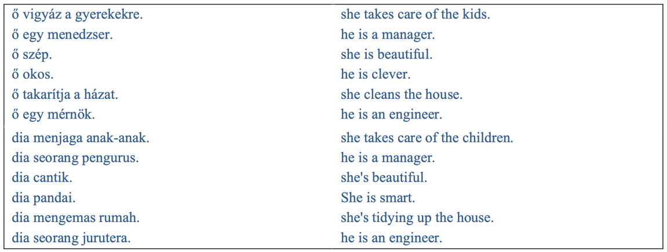
6.2 Reproduction of biases
AI system also reproduce biases and structural disadvantages for certain groups. In a famous study, Buolamwini and Gebru (2018) evaluate commercial AI-gender classification systems. A first problem is that the training data contains on average around 80% of lighter-skinned persons. They also find that these commercial gender classification systems have error rates of up to 34.7% for darker-skinned women, while the error rate for light-skinned men is 0.8%.
Bender et al. (2021) show that large language models are not necessarily diverse in its results. It has to do with the persons contributing to content on the internet as one factor. Translation using AI system is reflecting inequalities and biases in society.
The table below shows the limits and gender biases in automatic translation. There is a tendency to identify better paying jobs with males and caring professions with females. The sentences below are Hungarian and Malay. Although, there is no indication of gender in the sentences below, the automatic translation identifies men with managers and intelligences and women with caring professions and beauty. It is easy to understand the reasoning of the AI system but it is also obvious that these translations help to preserve stereotypes.
Misclassifications and errors can also often be found. In 2015, a Black software designer tweeted that Google’s image recognition software was misclassifying him and a black female friend as gorillas. Understandably, the tweet caused a PR disaster for Google and the company blocked image searchers for gorillas, monkeys, chimps and chimpanzees since then. The same error happened at Facebook in 2021. Users who were watching a video featuring Black men were asked if they wanted to watch more “videos about primates” (Jones 2021).
This points towards the implications of errors but also the difficulties of the technology.
Table 7: Translation of gender-neutral sentences
Source: Spiess-Knafl (2022)

Slide 48
6.3 Bias Against Minorities
Bias in AI systems can lead to discriminatory outcomes that disproportionately affect minority groups. This bias can manifest in various ways, including unequal access to services, biased hiring practices, and unfair treatment by automated systems. For example, facial recognition technologies have been found to be less accurate in identifying individuals with darker skin tones, leading to higher rates of false positives and false negatives for these groups. Similarly, AI-driven hiring platforms may inadvertently favor candidates from majority groups due to biased training data, perpetuating existing inequalities.
Bias in AI systems can arise from several factors, leading to significant ethical and social implications. AI systems learn from historical data, and if this data reflects existing biases, the AI can perpetuate or even amplify these biases. For instance, if an AI system is trained on historical hiring data where certain demographics were underrepresented, it may learn to favor similar candidates, thus reinforcing systemic discrimination.
The implications of bias in AI systems are far-reaching, affecting fairness, equity, and trust in AI technologies. Unchecked bias can lead to loss of opportunities, unfair treatment, and harm to marginalized communities, undermining the potential benefits of AI.
The choice of algorithms and how they are configured can introduce bias. For example, certain algorithms may inherently favor majority groups if not properly balanced.
A bias can also be introduced during the implementation phase, where the deployment context may inadvertently favor certain groups over others. For example, language models deployed in specific regions may not account for local dialects or minority languages.
Once deployed, AI systems may reinforce their own biases through feedback loops, where biased outcomes lead to further biased data, perpetuating a cycle of discrimination.

Slide 49
6.4 Privacy
Even anonymous data can often be linked to certain persons. A famous example is the de- anonymization of the Netflix Prize dataset. Netflix has shared the anonymous movie rating of 500,000 individuals. Narayanan and Shmatikov (2008) have used the Internet Movie Database to successfully de-anonymize users from the dataset. Their results are impressive as “8 movie ratings (of which 2 may be completely wrong) and dates that may have a 14-day error, 99% of records can be uniquely identified in the dataset. For 68%, two ratings and dates (with a 3-day error) are sufficient”. This has important implications as the de-anonymization might reveal political or sexual preferences.
Other issues include data glitches. For example, autonomous weapon systems operate on data that are often faulty. Disinformation is another concern (Buchanan et al., 2021) or the energy needs of language models (Bender et al. 2021). At least, the energy needs are more efficient than the operation of some cryptocurrency networks.
The use of AI technologies raises significant privacy concerns, particularly related to the collection, storage, and use of personal data.
The ethics of data collection hinge on obtaining informed consent and ensuring that individuals are aware of how their data will be used.
AI technologies, such as facial recognition and predictive analytics, enable extensive surveillance capabilities. While these technologies can enhance security, they also pose risks to individual privacy and can lead to unwarranted surveillance and profiling.
Striking a balance between technological innovation and privacy protection requires careful consideration.
Strategies for protecting privacy while leveraging AI capabilities include:
  Implementing transparent data practices and holding organizations accountable for data misuse.
  Providing users with control over their data, including options to opt-out or limit data sharing, can enhance privacy protections.

Slide 50
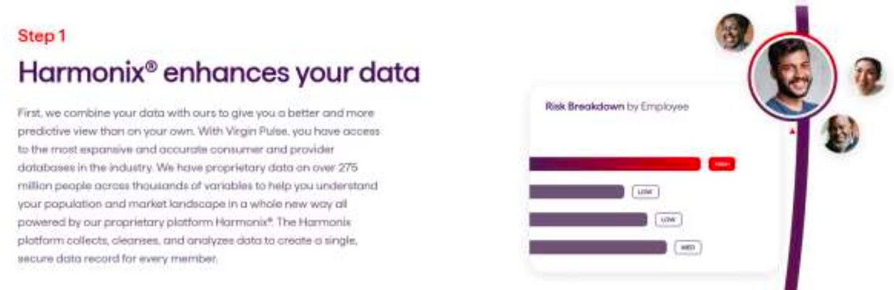
6.5 Intellectual property
You might remember the example of Virgin Pulse. They have collected data on 275 million people which they use to offer services. Nobody has really given his explicit permission that his or her data is used for these purposes. See screenshot below.
There are many instances where public data is being transferred to private companies. In this context, the data sharing agreement between the Royal Free Hospital and a Google’s AI subsidiary, DeepMind, is often discussed:
DeepMind received access to five years of patient data to predict acute kidney injuries. The results would then inform the development of a app to provide information about a patient situation. The data sharing agreement raised concerns as patients might not be willing to share sensitive health data with a Google subsidiary (Hawkes, 2016). It was later found that the data was shared on an inappropriate basis although the effectiveness of the app was confirmed (Iacobucci, 2017).
This illustrates the tensions between the need to have good data to develop useful products but also the trust which is needed in this area. Later, when Deep Mind’ health team joined Google Health, researchers pointed that there is a need to address the deficit of trust to unlock the opportunities of the technology (Morley et al., 2019).
There are also other instances. For example, web crawlers collect information from the internet to use it for all kind of different purposes. Nobody asks the creators and writers if they do consent in having their work used for whatever purpose.

Slide 51
6.6 Methods for Detecting and Mitigating Bias and Auditability
Bias often originates during data collection and preparation. Mitigating this involves sourcing diverse data to represent all demographic groups and using data augmentation methods like oversampling and synthetic data generation. Preprocessing techniques such as reweighting samples, anonymizing data, and handling missing data fairly also reduce biases before model training begins.
Algorithmic solutions are vital for addressing bias during model training. Fairness-aware algorithms embed fairness constraints within learning processes to balance accuracy and equity. Adversarial debiasing trains models alongside adversarial networks to detect and minimize bias. Post-processing techniques, like adjusting thresholds and re-ranking outputs, ensure fairness after training.
Reducing bias requires a commitment to best practices and ethics. Inclusive design involves engaging diverse stakeholders to reflect varied perspectives. Transparency and accountability are critical, with clear documentation and explanations of model decisions. Continuous monitoring and feedback loops allow for ongoing bias detection, and ethical frameworks guide the development of AI systems that prioritize fairness, accountability, and transparency.
Let us start with an audit pymetrics has commissioned. It is interesting as it outlines the aspects which are in the scope and outside of the scope of the audit by Wilson et al. (2021) During the audit we focused on the following specific questions:
(1) Correctness
(2) Direct Discrimination
(3) De-biasing Circumvention
(4) Sociotechnical Safeguards
(5) Sound Assumptions
Let us also take a look at everything which was outside of the scope of the audit (Wilson et al., 2021):
Just as important as defining what we were auditing is understanding what we were not auditing. This point is critical for properly contextualizing any audit, so as to focus on specific criteria for success or failure. In particular, our audit did not cover the following aspects of pymetrics’ products and business.

Slide 52
6.8 Ethical Responsibilities of Employers
Employers have significant ethical responsibilities to ensure that AI systems used within their organizations are fair and supportive of all employees.
Employers should be transparent about how AI is used in their organizations. Clear communication about the purpose, functioning, and impact of AI systems helps build trust and understanding among employees.
It can be considered to provide training on recognizing and mitigating bias in AI is essential for both employees and managers. This training should cover the ethical implications of AI, the sources of bias, and strategies for reducing bias in AI applications. Only a few companies are considering this to be important.
AI-driven decisions can sometimes negatively impact employees. Employers should develop support systems to assist those adversely affected. This includes providing opportunities for retraining and upskilling to help employees adapt to changes brought by AI technologies.
The use of AI in human resources, including hiring, performance evaluations, and promotions, should be governed by ethical guidelines. These guidelines should ensure that AI systems are fair, transparent, and free from discrimination.
Protecting employee data should be protected when using and training AI systems. Employers must ensure that data collection and processing comply with privacy laws and regulations, and that employees' privacy rights are respected.

Slide 53
6.9 Job Losses and social security
AI-powered automation is reshaping industries by driving efficiency, productivity, and accuracy. However, this progress often comes with the unintended consequence of job displacement. As AI and automation increasingly handle routine, repetitive, and even complex tasks, certain jobs are rendered obsolete, causing significant workforce reductions. Research suggests a large share of global jobs could be automated. This shift impacts sectors differently, with manufacturing, retail, and administrative roles facing the highest risk of automation.
To alleviate the negative effects of AI-induced job displacement, it is important to implement effective workforce transition strategies focused on reskilling workers to meet the demands of the evolving job market. Promoting continuous education and skill development is essential for helping workers adjust to new job requirements.
Government policies also play a crucial role in addressing job displacement due to AI. Investment in education, particularly in STEM (Science, Technology, Engineering, and Mathematics) fields and digital literacy, should be prioritized, alongside funding reskilling and upskilling initiatives to prepare the workforce for future employment opportunities.
Offering incentives to businesses that invest in workforce training and development can encourage employers to actively participate in reskilling efforts through tax credits, grants, and subsidies.
Social safety nets and support systems are also important for supporting displaced workers and ensuring a smooth transition to new employment.
Social security systems are meant to protect individuals from risks. The following elements are usually covered by social security systems (Forde et al., 2017):
  Healthcare (costs)
  Sickness (benefits paid during sick leave)
  Maternity (costs and benefits)
  Disability (benefits)
  Old age (pension benefits)
  Survivors (benefits)
  Employment injuries/accidents at work and diseases (costs)
  Family (benefits)
  Unemployment (benefits)
  Guaranteed minimum resources (benefits)
  Long-term care (costs)
Social security systems are managed differently across Europe. While some are tax-financed, others are contribution-based.
Social security rights are often tied to the employment status but there are exceptions. For example, in Germany homeworkers and artists enjoy social security protection disconnected from their employment status (Chesalina, 2018).

Slide 54





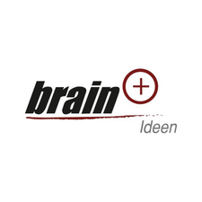



Thank You
For Your Attention
Funded by the European Union. Views and opinions expressed are however those of the author(s) only and do not necessarily reflect those of the European Union or the European Education and Culture Executive Agency (EACEA). Neither the European Union nor EACEA can be held responsible for them.

