Slide 1





STAY OK
Rethinking wellbeing at workplaces in the EU SMEs
Accessibility Issues
MODULE 4
2023-1-IT01-KA220-VET-000154571

Slide 2

SUMMARY
  Lesson 1: Importance of Accessibility in Small Business Settings
    2.1 The significance of accessibility for small businesses
    2.2 Impact of accessibility on employee well-being
    2.3 Case studies illustrating successful integration of accessibility measures
  Lesson 2: Identifying Barriers and Challenges
    3.1 Understanding diverse barriers faced by workers
    3.2 Uncommunicated barriers and their effects
    3.3 Technological barriers and their implications
  Lesson 3: Implementing Inclusive Design Principles
    4.1 Introduction to inclusive design principles
    4.2 Practical strategies for incorporating inclusivity into business practices
    4.3 Real-world examples of successful implementation

Slide 3
SUMMARY
  Lesson 4: Accommodating Employees with Disabilities
    5.1 Legal requirements and compliance obligations
    5.2 Best practices for accommodating employees with disabilities
    5.3 Creating an inclusive workplace culture
  Lesson 5: Accessible Communication and Technology Solutions
    6.1 Importance of accessible communication methods
    6.2 Overview of accessible technology solutions
    6.3 Practical demonstrations and applications
  Conclusion

Slide 4






LESSON 1
The significance of accessibility for Small Business
- What is Accessibility?
Impact of accessibility on employee well-being
- Meaning and Importance of Employee Wellbeing
- 7 Ways Small Businesses Can Improve Accessibility
Case studies regarding integration of accessibility measures

Slide 5
LESSON 1
ACCESSIBILITY DEFINITION
Accessibility is about removing barriers to enable full participation in everyday activities for all users, especially those with disabilities.
This involves developing user-friendly physical and digital environments.
In terms of digital functionality, these include things like keyboard navigation, screen reader compatibility, and video captioning. It has tactile elements, clear signs, large entrances, and ramps on the outside.
Businesses can create inclusive environments that value and support everyone's needs and encourage full participation in social, economic, and cultural life by putting accessibility first.

Slide 6
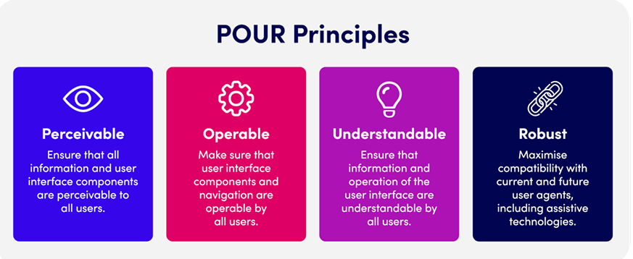
LESSON 1
Accessibility matters because it enhances Employee Well-Being, Business Reputation, Innovation and Inclusivity.
On the other hand neglecting Accessibility can lead to Legal Risk, Reduced Employee Engagement.
Accessibility is essential for Employee’s Physical and Emotional Well-Being and Accessible environments can foster Higher morale, Better engagement, Reduced turnover.

Slide 7
LESSON 1
Accessibility is essential in order to:
  Enhance business performance
  Promote diversity and inclusion
  Ensure legal compliance
Thanks to Accessibility, Small Businesses can:
  Attract a broader customer base
  Boost employee satisfaction and productivity
  Reduce legal risks and compliance issues
Technology can be used to promote employees Physical and Mental Wellness and to reach Flexible Work Arrangements.
When adopting Technology it is important not to forget about Data Privacy and Protection Concerns.
The increasing “Work from Home” may increase employee burnout. Therefore, work-life balance challenges may arise and should be solved through a helthy use of technology.

Slide 8







LESSON 1
7 Ways Small Businesses Can Improve Accessibility
Provide a Web Accessibility Statement
Include Audio and Video Transcripts
Provide Necessary Content Warnings
Ensure Adequate Colour Contrast
Use Headers to Structure Content Properly
Include Alt Text for All Images
Avoid Automatic Media and Navigation

Slide 9

Case Studies illustrating successful integration of accessibility measures
1. Retail Security Enhancement
CHALLENGE: increased theft, vandalism, and disruptive behavior, causing financial strain and safety concerns
SOLUTION:
  Collaboration with local police agencies to deploy off-duty officers.
  Identify high-traffic and vulnerable areas in stores.
  Officers as visible deterrents and for quick incident responses.
  Officers trained to balance security duties with positive shopper interactions.
OUTCOME:
  Significant reduction in shoplifting and disruptive incidents.
  Improved customer and employee confidence and morale.
  Enhanced customer engagement and increased sales.
  Long-term partnership showcasing a successful security model for other retailers.

Slide 10
Case Studies illustrating successful integration of accessibility measures
2. Event Security Amplification
CHALLENGE: Issues with crowd management, security threats, and attendee safety. The event's size and audience diversity exceeded the capabilities of traditional security measures.
SOLUTION:
  Integration off-duty police officers into the security team.
  Strategic Officer Placement
  Enhanced Expertise for crowd control, threat assessment, and emergency response.
  Efficient Coordination
OUTCOME:
  Improved crowd dynamics and rapid response to incidents.
  Enhanced attendee sense of security and enjoyment.
  Collaboration for boosting safety and fostering community.
  The approach became a benchmark for security at future large-scale events.

Slide 11
Case Studies illustrating successful integration of accessibility measures
3. Corporate Campus Security Reinforcement
CHALLENGE: unauthorized access, property damage, and workplace disturbances.
These threats jeopardized employee safety, productivity, and morale.
SOLUTION:
  Integration of off-duty police officers into the security team.
  Strategic Placement of officers for visibility and deterrence.
  Close collaboration with on-duty security staff for effective communication and response.
OUTCOME:
  Significant reduction in unauthorized entries and disturbances.
  Increased employee sense of safety and trust in the workplace.
  Improved overall work environment and morale.

Slide 12
Lesson 2
Understanding diverse barriers faced by workers
Understanding diverse barriers faced by workers
- How to break down obstacles to communication through various inclusion efforts
Technological barriers and their implications
- Upgrades - Dependency - Relationships
- How to Increase Productivity in a Company

Slide 13
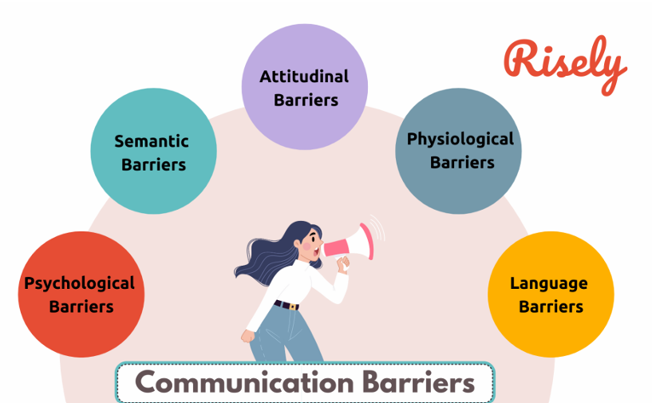

LESSON 2
Barriers and Challenges
Accessibility Barriers include:
Physical obstacles (e.g., lack of ramps)
Technological barriers (e.g., inaccessible websites)
Communication barriers (e.g., language differences)
For Diversity we need careful preparation and tailored strategies, as there is no universal approach. Senior leaders play a crucial role in fostering inclusivity by developing practical plans, engaging employees, and ensuring policies support a diverse and cohesive workforce while maintaining high performance standards.

Slide 14




LESSON 2
Possible Solutions to Accessibility Barriers
ADDRESSING PHYSICAL BARRIERS
Provide ramps, wide entrances, and tactile indicators; Use accessible layouts and signage
Effective Communication Strategies
Promote clear, inclusive communication; Train employees to recognize and respect diversity; Use multiple formats for information delivery
OVERCOMING TECHNOLOGICAL BARRIERS
Use accessible web design principles Incorporate screen readers and alternative navigation methods

Slide 15
LESSON 2
Technological barriers and their implications
Technology has dramatically accelerated business and production, improving efficiency and communication. Tasks that once took hours now take minutes, and instant messaging enables seamless global interactions. However, over-reliance on technology can lead to challenges like inflexibility, system failures, and reduced face-to-face communication, which can harm productivity.
To enhance productivity, empowering employees with tools and autonomy is crucial, alongside offering flexible working hours to improve morale and loyalty. Managing internet usage effectively and implementing user-friendly communication tools, such as instant messaging and email scheduling, can further streamline operations, reduce distractions, and foster a productive workplace.

Slide 16
Lesson 3
Introduction to inclusive design principles
- Key elements of Inclusive Design Practices
Practical strategies for incorporating inclusivity into business practices
- How can companies create a more inclusive and diverse work environment?
Real-world examples of successful implementation
- Slack: Offering a Real Worldview of Their Customers
- Fenty: Foundation for All
- Uber: Safety settings for drivers

Slide 17



LESSON 3
Inclusive Design Principles
Key Principles of Inclusive Design
Examples of Inclusive Design
Inclusive design ensures usability for everyone:
  Self-awareness of biases
  Transparent communication
  Accessibility integrated throughout product lifecycle
  User-friendly layouts
  Simplified navigation tools
  Adjustable features for diverse needs
  Writing Inclusive Job Ads
  Acknowledging religious, cultural, and awareness festivals
  Minimising unconscious Bias
  Benefits people of all abilities
  Promotes equity and accessibility

Slide 18
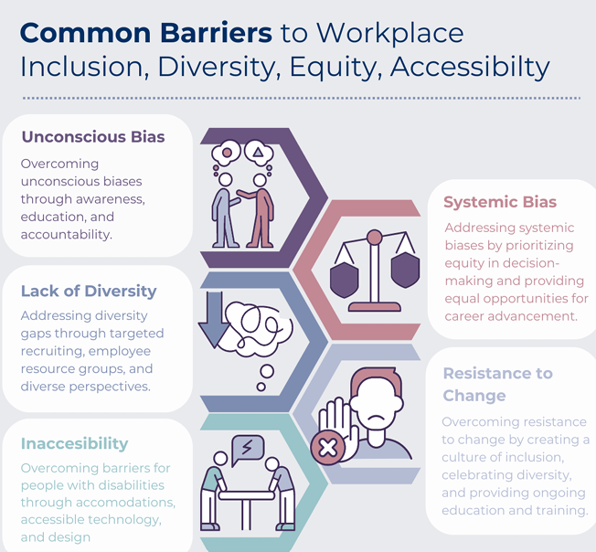
LESSON 3
Inclusive design makes products and services accessible to everyone, regardless of ability, age, or background. Promoting Adaptability is both a moral responsibility and a strategic advantage. Neglecting inclusive design can exclude key user groups, hindering growth opportunities and corporate expansion.

Slide 19



LESSON 3
Real-world examples of successful implementation
Fenty Beauty became one of the world's most successful makeup brands by prioritizing inclusivity in its product design.
Through its commitment to diversity and inclusion, Slack improves its brand identity and elevates user experience, creating a platform that is inclusive and accessible to everyone.
Uber aims to foster a more secure environment and build trust among its diverse user base, ensuring that everyone can travel with peace of mind

Slide 20
Lesson 4
Legal requirements and compliance obligations
- Web Accessibility
- Service Accessibility
- Staff Training
Best practices for accommodating employees with disabilities
Creating an inclusive workplace culture
- 7 Principles for Inclusive Design

Slide 21









LESSON 4
Accomodating Disabilities
Businesses that value inclusivity recognize the need for flexible hours, remote options, and specialized tools to support employees with disabilities. However, many still lack knowledge of effective ways to create an inclusive workplace.
Accomodations ensure equal opportunities
LEGAL REQUIREMENTS
Flexible Work Arrangements
  Compliance with Web Content Accessibility Guidelines (WCAG)
  Web Accessibility
  Service Accessibility
  Staff Training
Assistive technologies
Inclusive workplace policies

Slide 22



LESSON 4
Best practices for accommodating employees with disabilities
Reasonable accommodation involves workplace adjustments to enable individuals with disabilities to perform job functions, access benefits, and participate equally.
Adjustments to training, communication support, and inclusive hiring processes further ensure equal opportunities. Implementing such measures promotes diversity, inclusion, and enhanced productivity.
Examples include
ASSISTIVE TECHNOLOGIES
FLEXIBLE SCHEDULES
JOB RESTRUCTURING
REASSIGNMENT TO SUITABLE ROLES

Slide 23
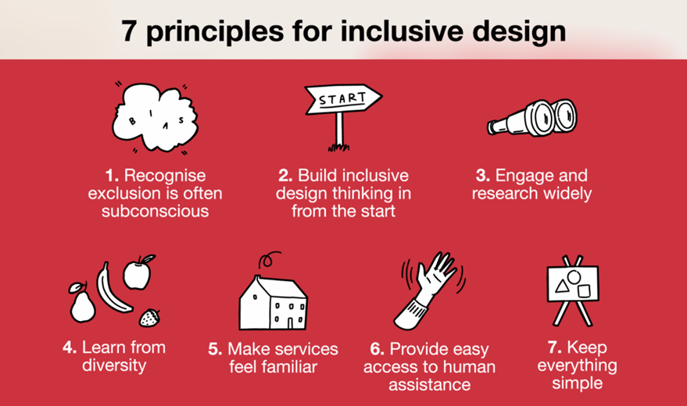
LESSON 4
Creating an inclusive workplace culture
Companies can promote inclusion by embedding disability inclusion into their mission, offering mentorship programs, and conducting mandatory disability awareness training to foster empathy and reduce bias. Feedback from employees with disabilities is key to improving initiatives, while open dialogue helps dispel misconceptions and build a supportive culture. Accessible recruitment processes, including assistive technology compatibility, ensure equal opportunities, benefiting both employees and the organization through a more diverse and equitable workforce.

Slide 24
Lesson 5
Importance of accessible communication methods
Overview of accessible technology solutions
Practical demonstrations and applications
- Voice Control
- Be My Eyes
- Seeing AI
- Google TalkBack
- Google Live Transcribe

Slide 25

LESSON 5
Types of Disabilities:
  Visual Impairment,
  Hearing Disability,
  Mobility Disability,
  Learning Disability,
  Speech Disorder
Inclusive Communication:
Common Assistive Technologies:
  Screen Reader,
  Assistive Keyboard and Adaptive Mouse,
  Dictation Software,
  Video and Audio Transcription
  Clear and simple language
  Formats accessible to all (e.g., Easy Read, Braille)
  Technologies like screen readers and voice recognition

Slide 26

LESSON 5
Overview of accessible technology solutions
Assistive technology is essential for creating accessible and inclusive educational environments. Accessibility ensures that everyone, regardless of disabilities, can engage with services, products, and spaces. Just as physical spaces require ramps, elevators, and braille signage, remote learning technologies must provide equivalent accommodations, ensuring both software and hardware are designed inclusively.
Assistive Technologies
  Screen readers and magnifiers
  Adaptive keyboards and mice
  Text-to-speech and speech-to-text tools

Slide 27




LESSON 5
Case Study: VOICE CONTROL
Control over the entire system
Inclusive and self-reliant User Interface
Assistance to those with disabilities

Slide 28

LESSON 5
Case Study: Be My Eyes
A GPT-4 powers Virtual Volunteer to integrate into their app. This virtual volunteer seeks to provide equivalent context and comprehension as a human volunteer, utilising the visual input capabilities of GPT-4 to enhance assistance for the visually impaired community.

Slide 29

LESSON 5
Case Study: SEEING AI
Reads Text Aloud
Recognizes Faces and Emotions
Assists Visually Impaired Users

Slide 30

LESSON 5
Case Study: GOOGLE TALK BACK
Enhancing the inclusivity and accessibility of Android devices for users with various disabilities. TalkBack, a screen reader, audibly communicates feedback to individuals with visual impairments by reading aloud on-screen text, buttons, icons, and other elements. This functionality facilitates navigation of devices, interaction with applications, and access to information. Additionally, TalkBack enables blind users to navigate the interface using braille input and output.

Slide 31

LESSON 5
Case Study: Google Live Transcribe
Real-time speech-to-text transcription
Enables effective communication for hearing-impaired users
Enhances inclusivity

Slide 32
CONCLUSION
Accessibility and Inclusion are NOT only ethical imperatives but also strategic advantages for small businesses. They are fundamental for the success and sustainability of any business. They will also lead to increased innovation, employee satisfaction, and customer loyalty.
This is an ongoing commitment and it is essential to continuously evaluate and improve practices!

Slide 33








Thank You
For Your Attention
Funded by the European Union. Views and opinions expressed are however those of the author(s) only and do not necessarily reflect those of the European Union or the European Education and Culture Executive Agency (EACEA). Neither the European Union nor EACEA can be held responsible for them.

