Slide 1





STAY OK
Rethinking wellbeing at workplaces in the EU SMEs
TRAINING CURRICULUM
OVERVIEW
2023-1-IT01-KA220-VET-000154571

Slide 2

The STAY OK project
  STAY OK offers a set of innovative tools for European small businesses to reorganise, meet current and future HR challenges, reduce the gap with large companies and grow.
  STAY OK develops, tests and transfers an innovative VET programme aimed at leaders of small companies active in the professional service sector.
GOALS:
  Reducing the gap with larger companies
  Grow more easily. This means investing money, increasing the company's attractiveness in the labour market,
  Hiring new employees, fulfilling its Mission and realising its Vision.
  Increasing employee satisfaction and meeting their expectations.
  Curbing the trend of great resignation

Slide 3
OBJECTIVES
  UNDERSTANDING BLOCKAGES AND SKILLS GAPS IN SMALL COMPANIES WITH REGARD TO THE ISSUE OF WELL-BEING AT WORK
  OVERCOMING BOTTLENECKS THROUGH INNOVATIVE TOOLS AND ACTIONS IN THE VET
  ENSURE THE SUSTAINABILITY OF PROJECT RESULTS OVER TIME AND AFTER THE DATE OF CONCLUSION OF THE PROJECT
STAY OK intends to address this challenges, focusing in particular on small businesses working in the professional and consulting services sector, increasing their attractiveness in the labour market and helping to reverse the trend of great resignation.

Slide 4








PARTNERSHIP
EXEO LAB srl -
IT
Maltese Italian Chamber of Commerce - MT
Munich Business
School GmbH - DE
Gestión Estratégica e Innovación SL - ES
Brainplus
GmbH - AT
We Are
Entrepreneurs - DK

Slide 5
















Work Packages
WP 5 - COMMUNICATION, DISSEMINATION & EXPLOITATION
WP 1 - MANAGEMENT
WP 2 - KNOLEDGE ACQUISITION
WP 3 -
TRAINING CURRICULUM
WP 4 -
HANDOVER & SUSTAINABILITY

Slide 6

PR2 - Training Programme
for Small Business Leaders
Structured on 6 training modules covering staff welfare strategies, AI systems, disability management, community wellbeing policies, and work/life balance.
Tested on 120 small company leaders, fine-tuned based on feedback.
Course duration:
62 hours, including 42 hours of training + 20 hours of Work-Based Learning.
Course and handbook for VET Providers promoted and explained in-depth through in-formative and workshop sessions.

Slide 7
Module 1 - Career Planning in SMEs
The module focuses on career planning and workplace well-being for SMEs in Europe, emphasizing its importance in aligning individual aspirations with organizational goals.
It emphasizes the need for structured strategies, such as skill evaluation, self-assessment, and continuous training, to enhance employee satisfaction, productivity, and competitiveness.
  The module also presents case studies of successful career development strategies in SMEs, emphasizing the importance of aligning individual development with business goals.

Slide 8
Module 2 - Hybrid Work Strategies
The future of the workplace is hybrid, requiring effective implementation in organizational culture. This module focuses on understanding hybrid work, its organization, communication, and collaboration.
It aims to equip individuals with knowledge, skills, and competencies to set up, organize, and integrate hybrid work.
Learning Outcomes: The learning outcomes include understanding hybrid workplaces, their organizational and technical aspects, implementation, efficiency, communication, collaboration, and organizational competence in setting up and organizing hybrid working days.

Slide 9
Module 3 - AI for Worker Management
The module focuses on understanding the labor market context and the underlying technology of artificial intelligence (AI).
It aims to increase the performance and efficiency of corporate workforces, particularly using AI. Worker management is an approach of overseeing and guiding employees to ensure effective performance, including recruitment, performance evaluation, training, and development.
  The module will cover job matching, recruitment, and employee performance evaluation, and will conclude with an ethical discussion on the ethical implications of using AI in worker management, including issues such as biases, privacy concerns, and transparency of AI outputs.

Slide 10
Module 4 - Accessibility issues & mental well - being
The "Accessibility Issues and Mental Well-being" module aims to teach participants the importance of inclusivity in small business settings.
It covers five lessons, focusing on accessibility, barriers, inclusive design principles, legal requirements, and accessible communication and technology solutions.
  The module aims to empower participants to create more inclusive workplaces, promoting employee well-being and productivity. It also focuses on fostering an inclusive culture, promoting employee well-being, and overcoming accessibility challenges.

Slide 11
Module 5 - Community well - being
This module focuses on Community Well-Being, providing a framework for understanding, assessing, and promoting well-being within SMEs. It explores the concept's social, economic, environmental, and cultural dimensions, equipping learners with practical tools to evaluate community well-being and implement strategies for enhancement.
The module emphasizes collaboration and engagement, emphasizing the importance of community involvement and partnerships.
  The learning outcomes include theoretical knowledge, skills in assessing community well-being, critical thinking, leadership, and sustainability competencies, and the ability to analyze community well-being issues, inspire collective action, and design sustainable strategies.

Slide 12
Module 6 - Life Work balance
Life-Work Balance is a module designed for small business owners and solopreneurs to help them balance work and personal life. It emphasizes the importance of integrating work and life harmoniously, rather than aiming for an equal distribution of time.
The module consists of five key lessons: Understanding Life-Work Balance, Strategies for Managing Stress and Preventing Burnout, Setting Boundaries and Establishing Life-Work Integration, Time Management Techniques and Productivity Tools, and Building Resilience and Coping Skills.
  The learning outcomes include theoretical knowledge, skills, and competencies, focusing on life-work balance, time management, resilience, and effective workload management, demonstrating proactive approaches and self-care routines.

Slide 13


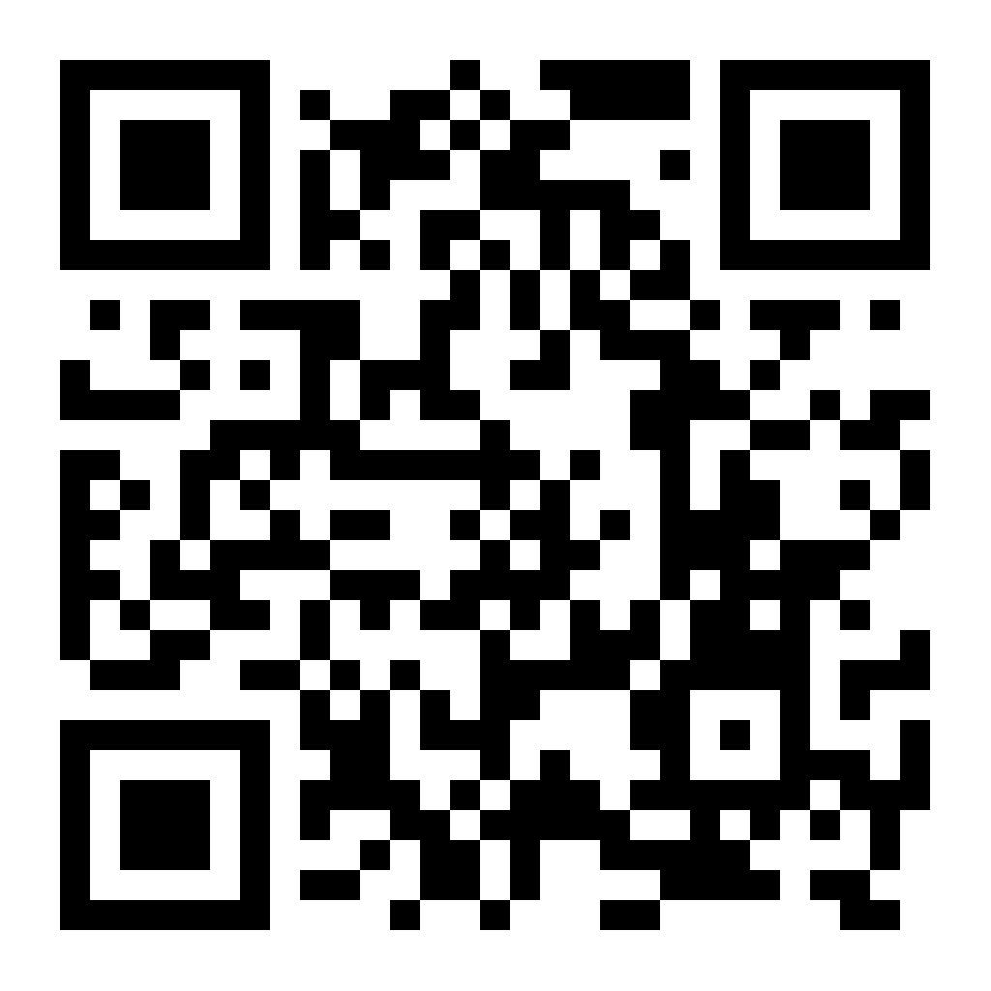
MOOC
A powerful OER for advanced training in the field,
which is based on the 6 modules of the tested and validated training curriculum.
Digital Tool
for the self-assessment of wellbeing in the company
An innovative digital tool to support small business leaders in self-assessing the level of workplace well-being in their company.

Slide 14
CONCLUSION
STAY OK Project: Addressing Workplace Well-being
• Focuses on SMEs in the professional and consulting services sector.
• Bridges gap in VET and HE offerings with courses on career planning, hybrid work, AI for HR management, disabled workers, community wellbeing, and work/life balance.
• Supports VET community in course reuse and delivers Digital Tool for staff wellbeing assessment and corrective actions.
STAY OK is a transnational study focusing on understanding and addressing skills gaps in small companies regarding well-being at work. The project aims to develop a training curriculum for small business leaders, focusing on career planning, flexible work mechanisms, artificial intelligence, community wellbeing policies, and work/life balance.

Slide 15







Thank You
For Your Attention
Funded by the European Union. Views and opinions expressed are however those of the author(s) only and do not necessarily reflect those of the European Union or the European Education and Culture Executive Agency (EACEA). Neither the European Union nor EACEA can be held responsible for them.

